Slide 1




Government Mobility Best Practices: The NCDA Story
Mi-Co and NCDA&CS Webinar
Dwight E. Seal
Robert Travis Snodgrass
Moderated by Tom Suder

Slide 2
Poll 1

Slide 3
WHY?
Tired of the paperwork shuffle
Knew there was a better way to deal with paperwork
Data management through manual entry was horrible = bad data such as missing elements, error in entry
Efficiency and accountability
Technology exists

Slide 4
Project Overview
Project Goal Deliverables
  Project to include:
    Design all inspection new forms with backend databases
    Design a template to build new forms
    Develop an approval dashboard for Supervisors
    Design a reporting feature with the data generated to be used for performance reviews, EPA reporting and state reporting

Slide 5
Project Team Members
    NC Department of Ag - IT Staff
    Jane Price, Mary Jo Gilliam, Tom Williams, Stuart Medlin
    Structural Pest Control and Pesticides Division Staff
    Pat Farquhar, Travis Snodgrass, Shannon Joyner, Gwen Van Duyn, John Dalley, Pat Jones, Dwight Seal
    Mi-Co
    Joel Farmer, RJ Fabian, Chris DiPierro, Gautham Pandiyan
    Ron Saffell

Slide 6
Timeline for Project
2005-06 Attended Mi-Co’s Mobility Summit in RTP, NC
2007 Entered into Phase I, secured USDA funding for USDA RK inspection program. Developed Notice of inspection form and WPS form
2009 initiated Phase II, expanded project by adding more users and 6 more forms

Slide 7
Cont.
2011 Completed Phase II
2011 Initiated Phase III developed 10 form for a full compliment of our field forms.
2012 April went live with Mi-Forms with no paper backup or manual data entry
2014 today Could not be happier

Slide 8
What it takes!
Windows based hardware such as tablet pc, iPad, or smartphone
Mi-Forms server
SQL server
License for each machine running the Mi-Forms software
Designer license for form development
Budget for AIMS paid annually
Great IT personnel

Slide 9

Workflow of Paper Based System
Inspector completes
Paper form
Mailed to Supervisor
via USPS
Supervisor Approval
Data Analyzed
Manually entered data
in Raleigh office
Mailed via USPS
to Raleigh

Slide 10


Workflow of Mobile Forms
Upload via
internet
Downoad via
internet
Inspector completes form
Miform Server
Supervisor / Analyst
Approval/Rejection
Approval Dashboard
Reporting
Data Analyzed
Miform Server
Saved in backend database

Slide 11
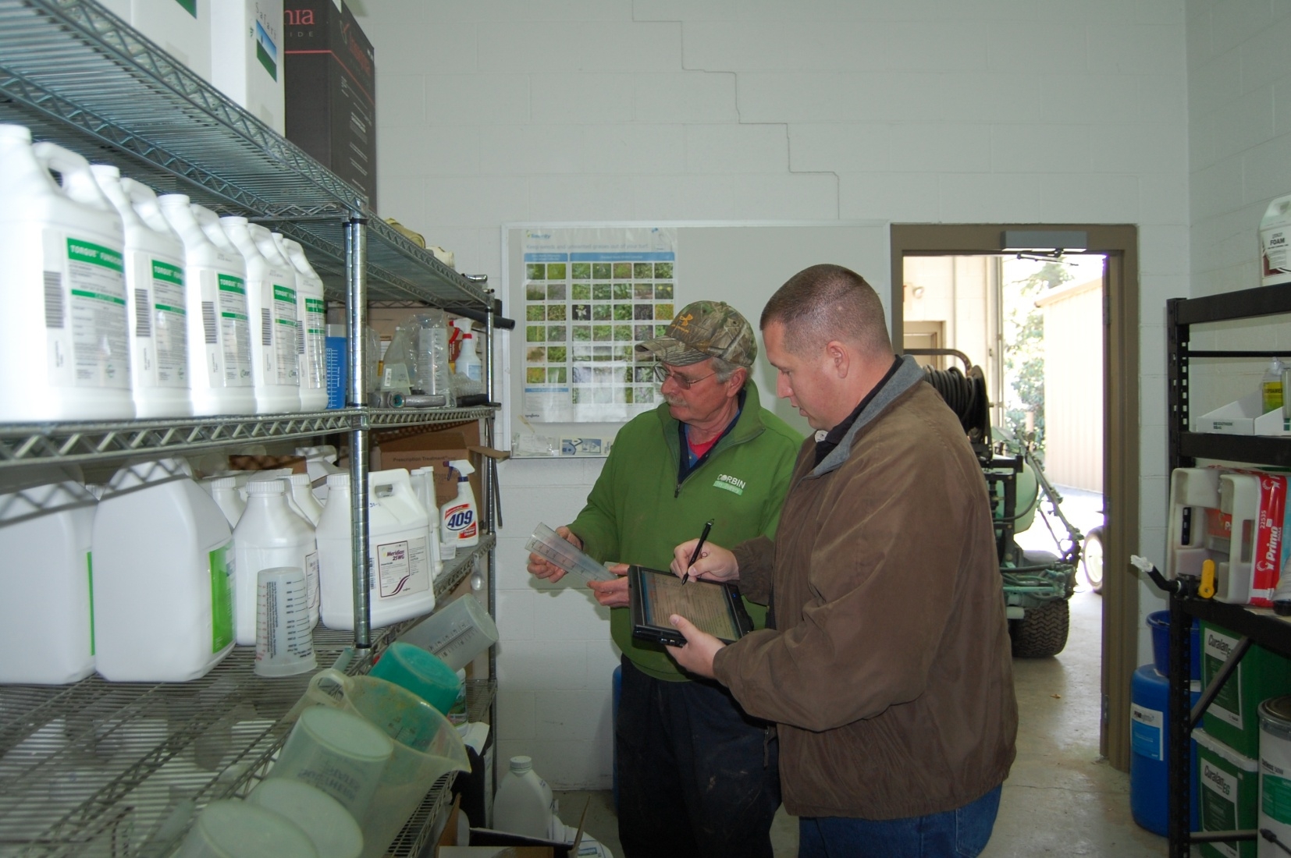

Slide 12
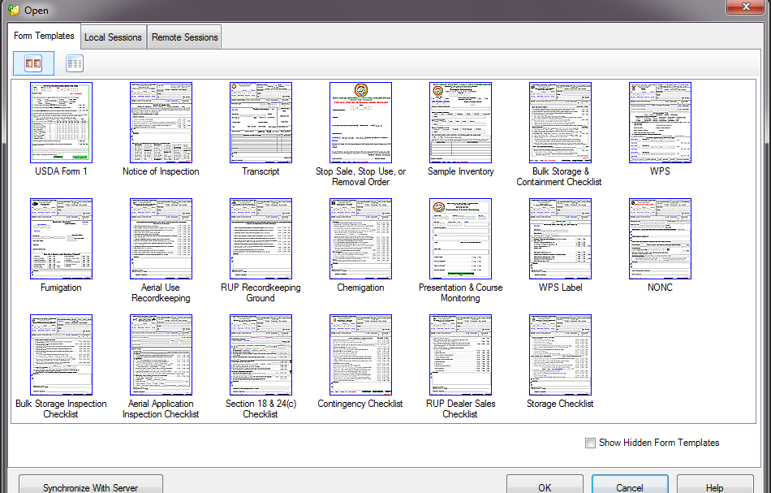

Slide 13
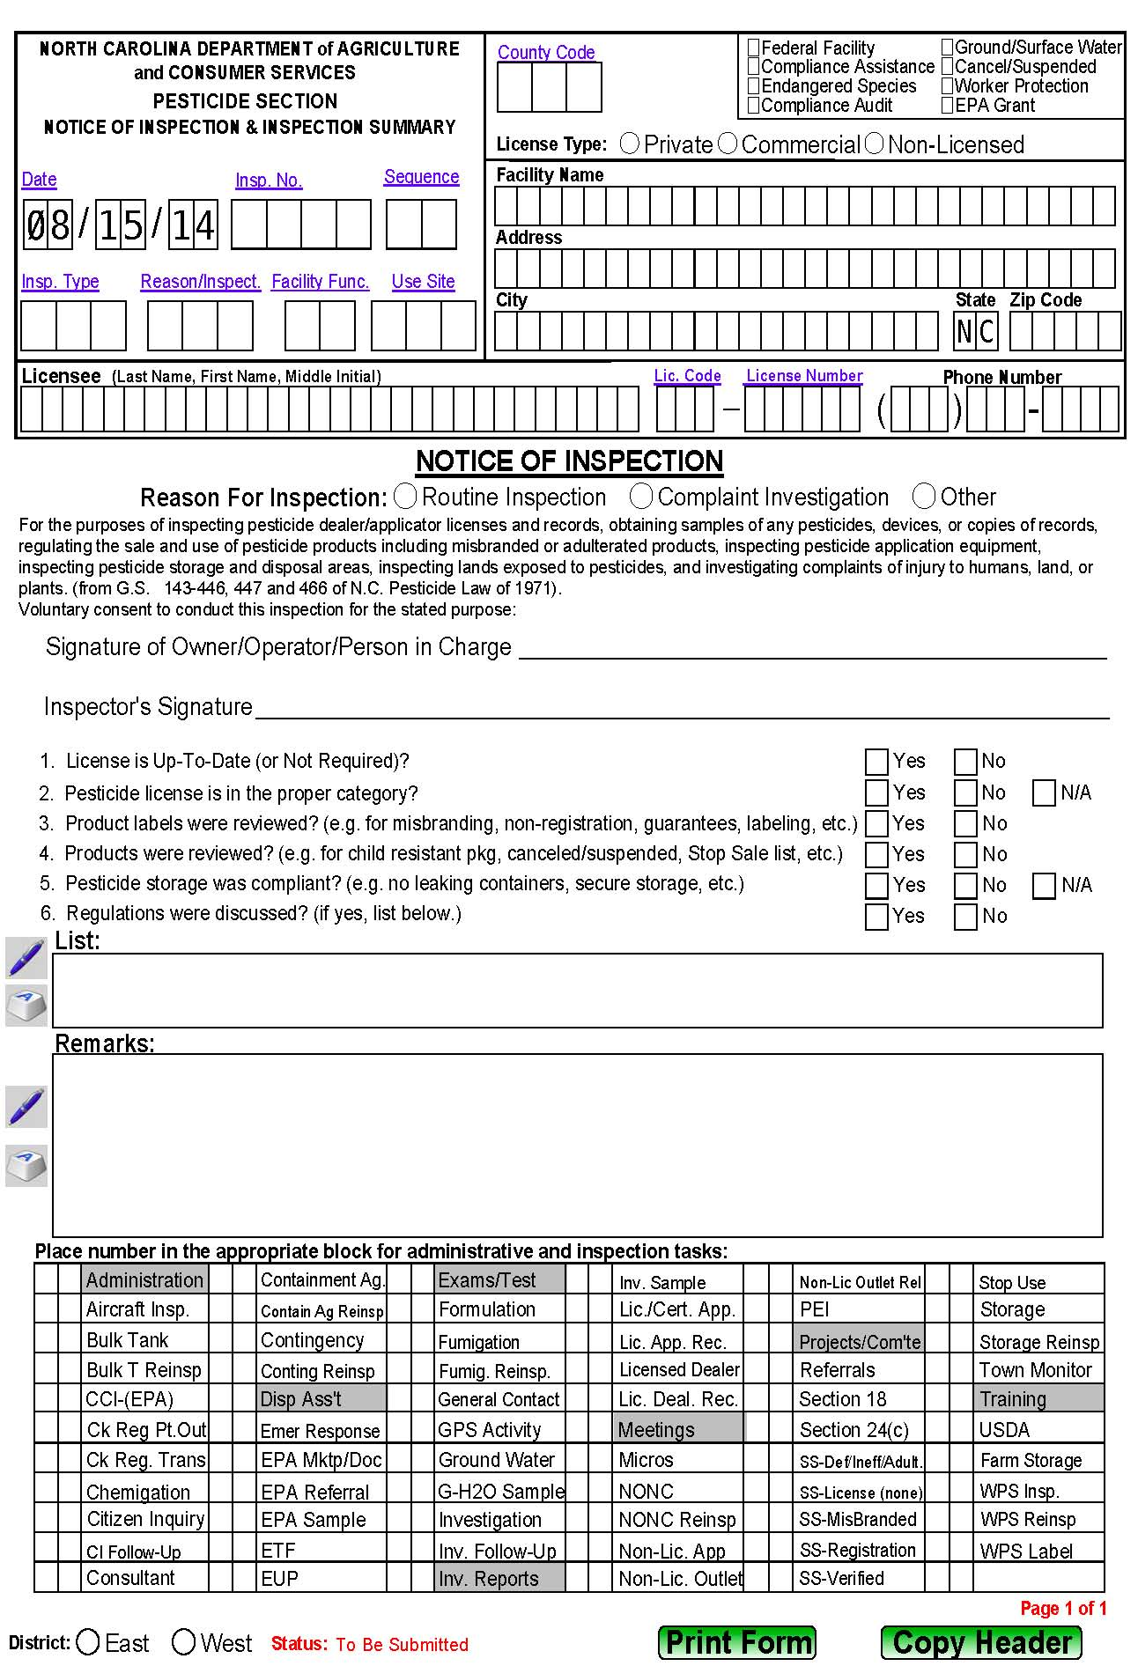
Header
Signature
Lines
Area to record inspection details
Inspection
Tasks
Copy Header

Slide 14
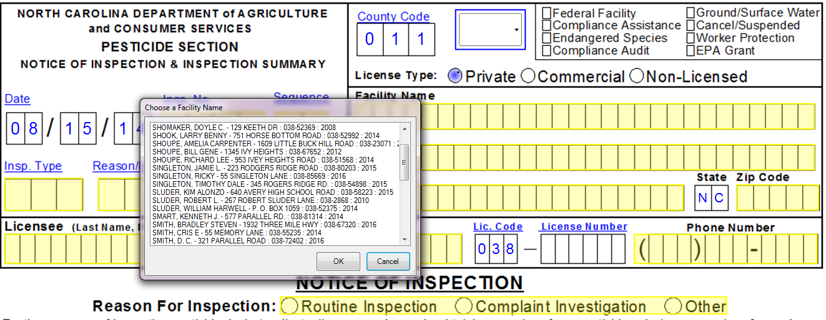
Auto Fill form using searchable database or license number

Slide 15
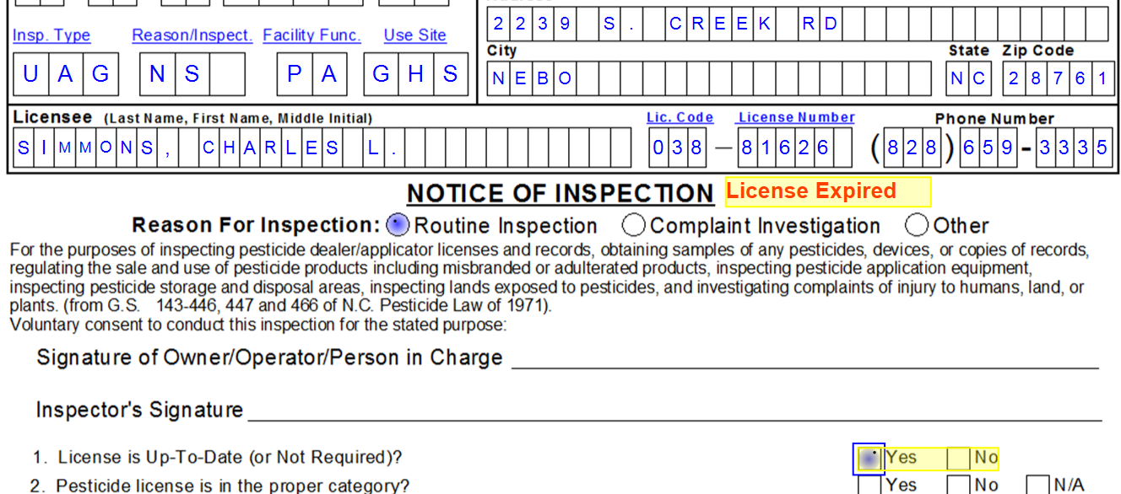
Logic built into forms to prevent erroneous data and facilitate good inspections

Slide 16
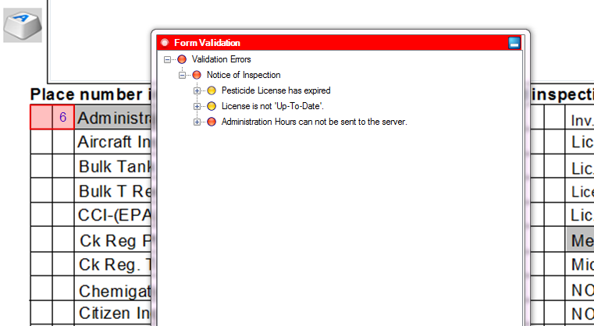
Validation points serve as reminders to inspectors

Slide 17
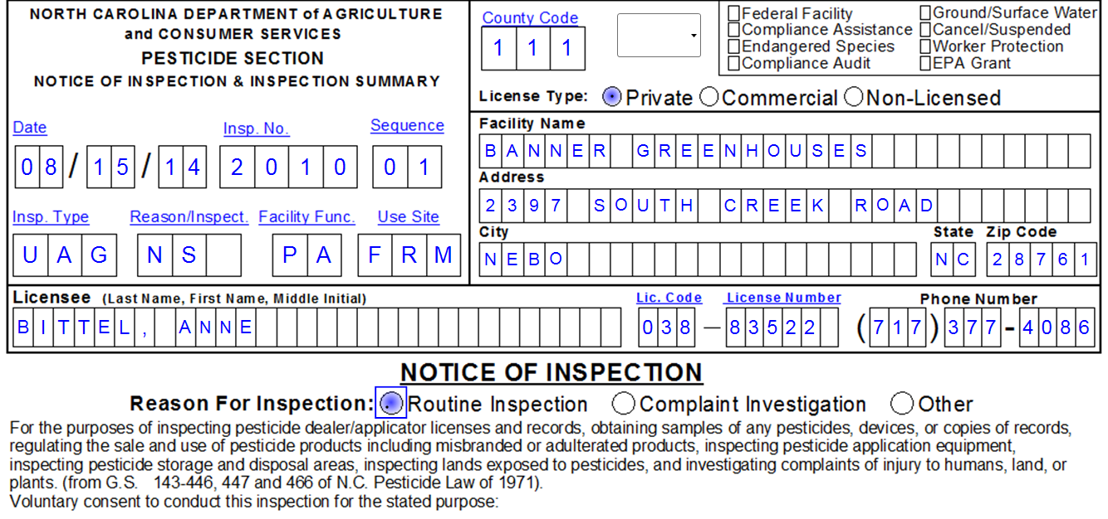
Completed Header

Slide 18
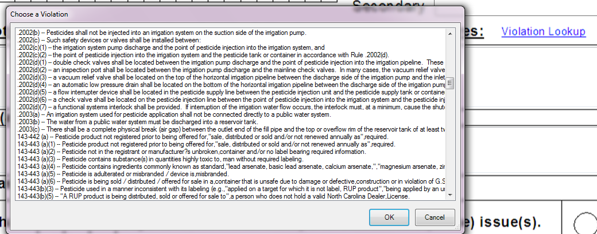
NC Pesticide Law & Regulations database linked and accessible within the forms

Slide 19
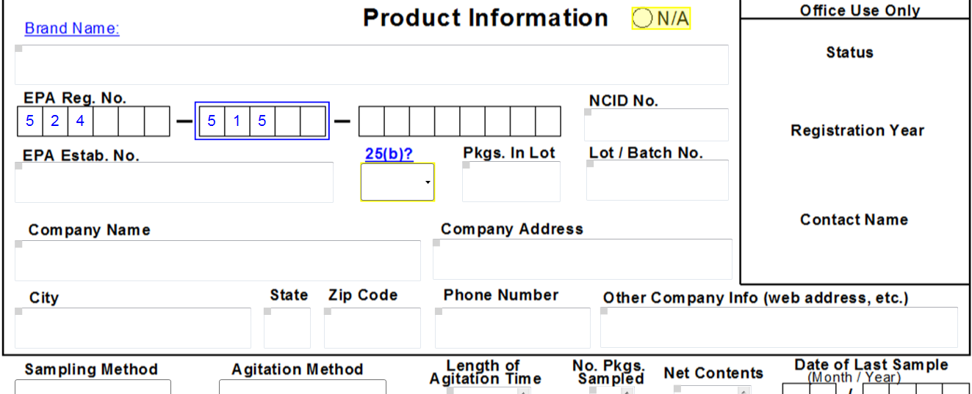
Product Information and Lab Data linked and accessible within the forms

Slide 20
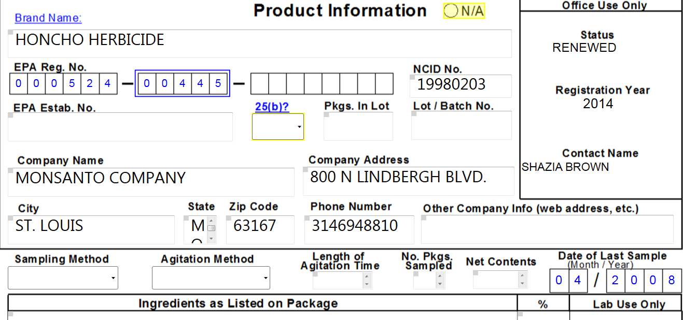
Form is populated with registration and lab information

Slide 21
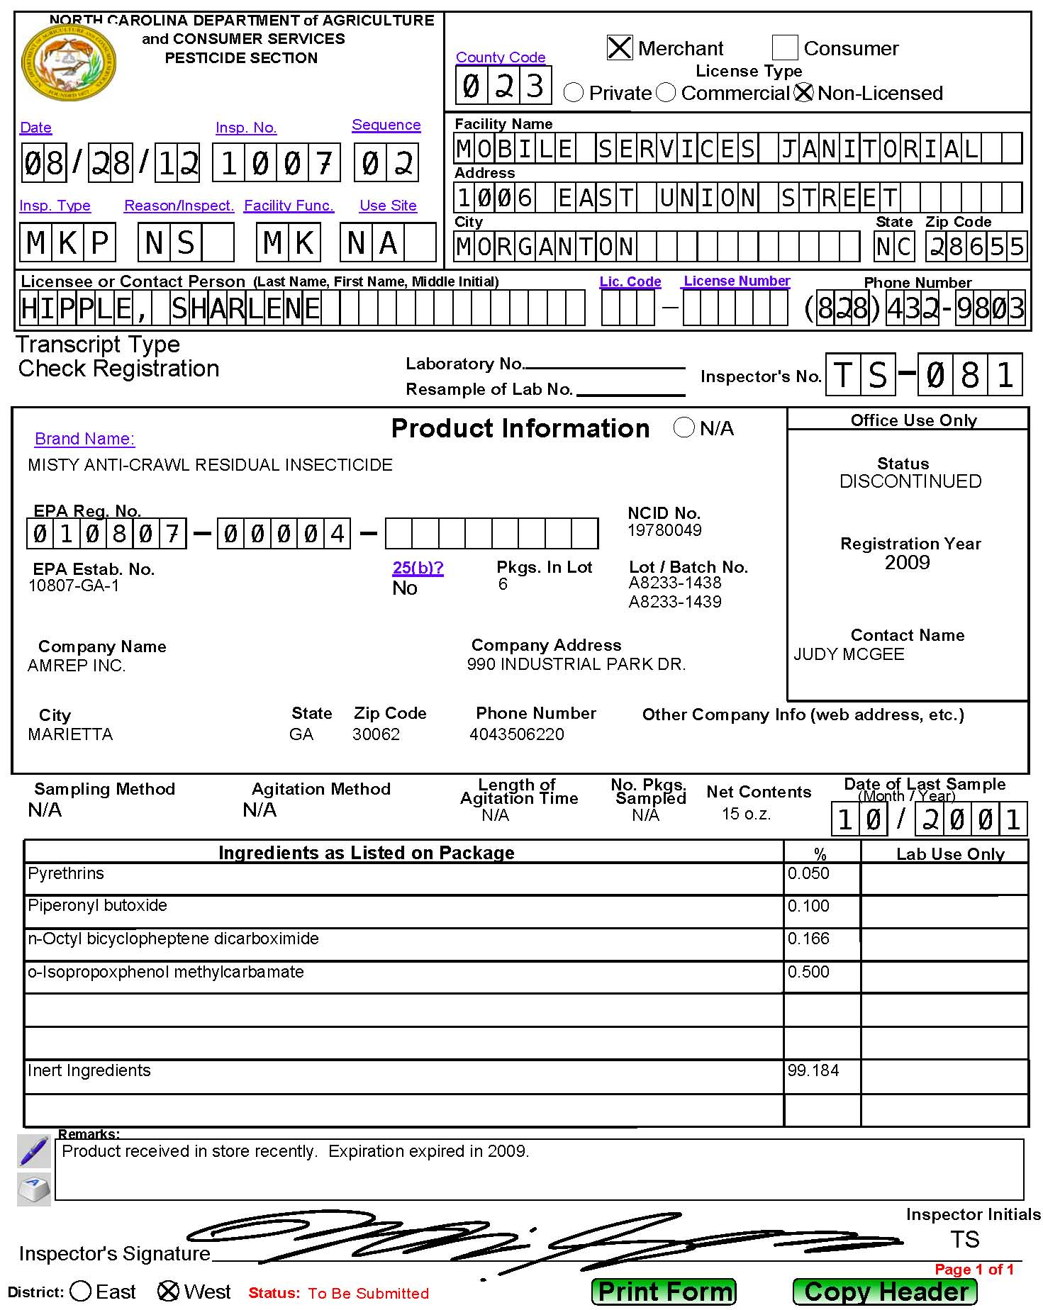
Completed Transcript

Slide 22
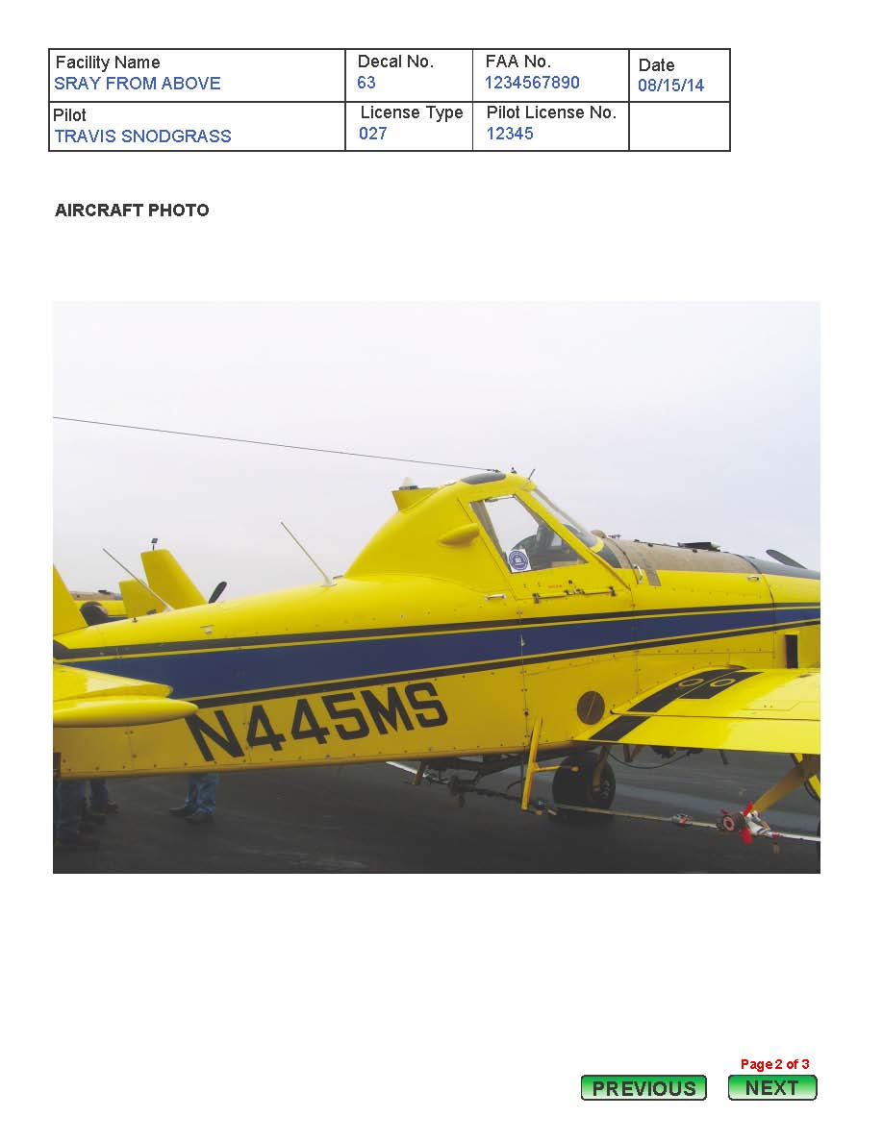
Photos incorporated
into inspection forms

Slide 23
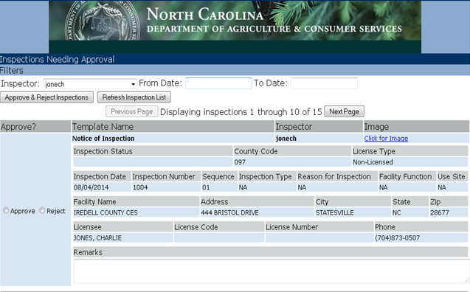
Approval Dashboard
Can click to see an image of the full form
Inspector’s Forms
Summary of Inspection Form
Approve or Reject the Form

Slide 24
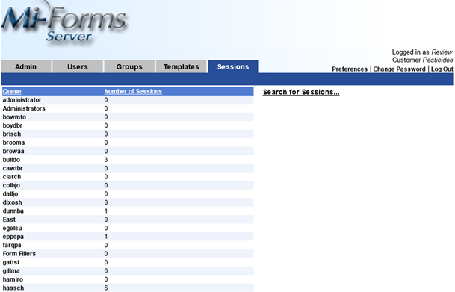
Mi-Forms Server
Any form can be found using search feature
Inspectors, Managers, & Finish Queues

Slide 25
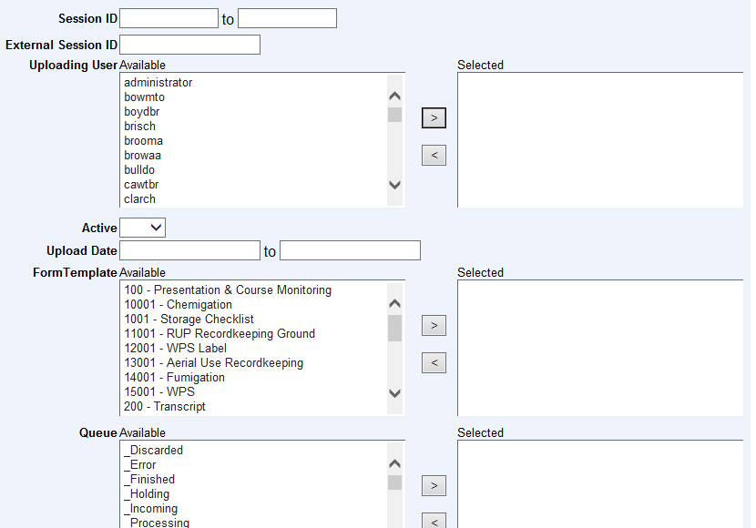
Server Search Feature
Search Criteria

Slide 26
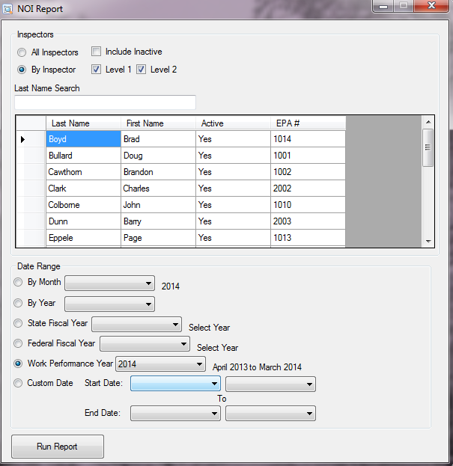
Reporting from Data Collected
Select Inspector Criteria
Select Inspector
Select Date Criteria
Run Report

Slide 27
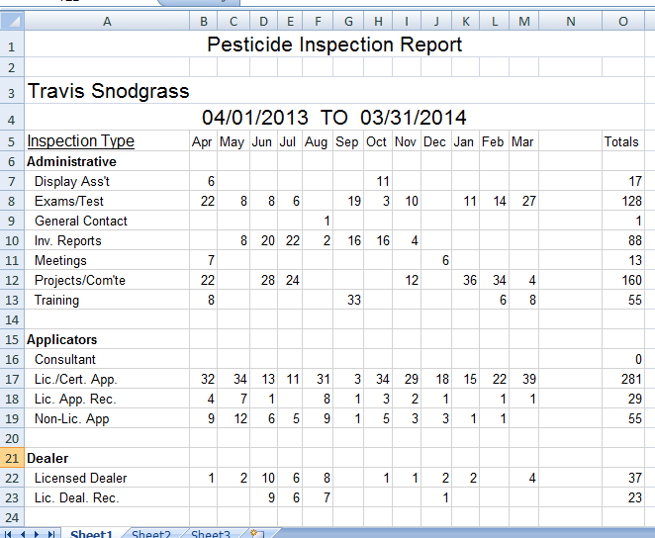
Reporting from Data Collected
Inspector
Date Range
Inspector Numbers from Bottom of NOIs
Total for Selected Date Range
Sorted by Month

Slide 28
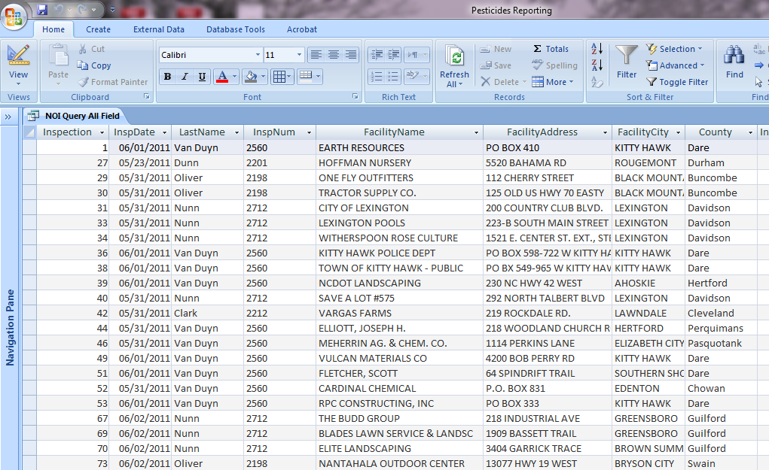
Reporting from Data Collected
All Data Replicated to Microsoft Access for Additional & More Detailed Reporting

Slide 29
Return on Investment
Parameters in old process:
  19 field inspectors, completing 5 forms/day….
  Cost of paper-process: ~ $6,254/month
Costs to account for: software, services, training (internal/external), hardware, support etc.
Net Savings to date (after hardware cost, Mi-Co costs, training, travel, other items)
  $219,210.70 (and $72,791/year from here on/ yr.)
2-4 week process reduced to 1 day, citizens happier too

Slide 30
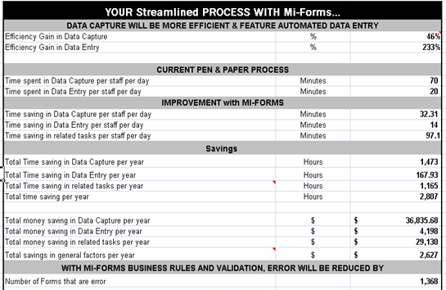
Return on Investment

Slide 31
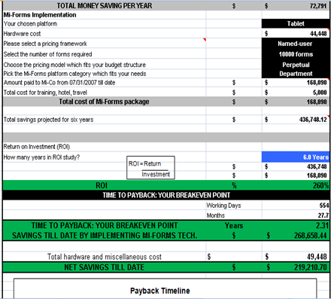
Return on Investment

Slide 32
Advantages of Mobile Form solution
Efficiency
Productivity
Accountability
Accuracy

Slide 33
Lessons Learned
Total “Buy-in” needed from the top to the bottom of the organization. (i.e. Division Director, IT Staff, Managers, Field Support Staff, & Field Inspectors)
Hardware issues were as big of a concern as software. Give the hardware a “Test-Drive”. Try out different equipment. Research!
Select team members wisely. Do not get all the same type people. Get visionaries, technical people, practical people, doers and not people who slow you down. Mi-Co was able to solve any issue that arose.

Slide 34
Best Practices from
Mi-Corporation
Create a solid business case
Invest with the right partners
Involve appropriate stakeholders
Phase your projects
Launch a robust training program
Plan for user adoption challenges
Measure success, communicate it!

Slide 35
Poll 2

Slide 36

The Mobility Interview!

Slide 37

Announcing….Next Month’s Webinar
Training for Mobility Success
Sept. 24, 10:30 am EST
Greg Clary, PhD,
Mi-Corporation CEO & Co-Founder
Featuring customer examples, tips, tricks & more!

Slide 38
Poll 3

Slide 39
Pop Quiz

Slide 40
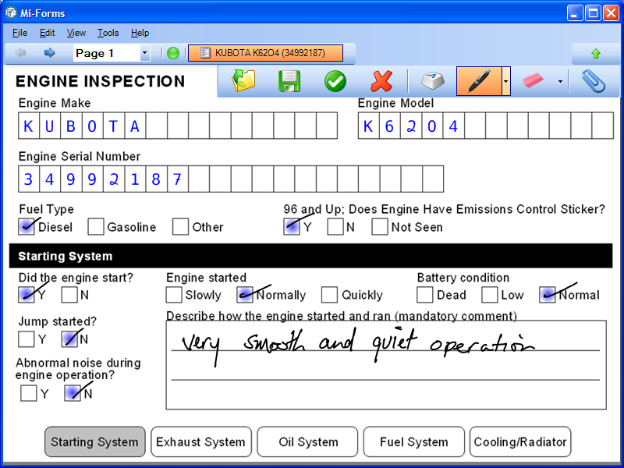
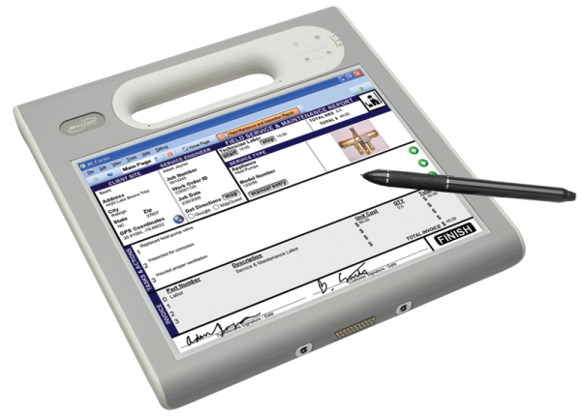
Audience:
Questions,
Comments,
Compliments?

Slide 41
Next Steps
Visit www.mi-corporation.com for more information about
Mi-Corporation Mobility Products: Data Sheets, Case Studies,
White Papers, Infographics & more
Downloadable Demo software is available at
www.mi-corporation.com
Look for Mi-Forms ON THE APP STORES (Apple, Android)!
Watch our YouTube videos: www.youtube.com/micortp
Contact Mi-Co to discuss your Mobility Projects!
Gautham Pandiyan
gpandiyan@mi-corporation.com
919-485-4819 x 1973

