Slide 1

Mobilizing your Mission Critical Processes
A Mi-Corporation Overview, Live Demo & Partner Training

Slide 2





Agenda
Introductions & Project Information
Mi-Corporation Corporate Background
Product Overviews
Production Presentation
Q&A, Wrap up, Summary, Next Steps

Slide 3






Mi-Corporation Corporate Overview
16+ years of Enterprise Mobility Software Experience
Enterprise Mobile Data Solutions to optimize mission-critical processes
Intellectual leadership
Partnered with industry leaders
Notes:
14 years of Enterprise Mobility Software Experience
- Founded 1999
Enterprise Mobile Data Solutions to optimize mission-critical processes
Mobile forms, Mobile Apps, Dashboarding products
Any data, Any Device, Anywhere!
Flexible, scalable, secure & mature (v10)
Partnered with industry leaders
- Intel, Microsoft Gold ISV, Panasonic, Motion Computing, Samsung,
Anoto & more
Intellectual leadership
10 issued US Patents, 3 more pending

Slide 4

Excellence in Innovation and Implementation of Customer Solutions

Slide 5








Select Mi-Corporation Customers

Slide 6



Mi-Corporation Mobile Impact Platform
Analytics
Notes:
Other Mobility Products Available from Mi-Corporation
Mi-Analytics
Field Inspection Dashboard/Database/Reporting system
Database tables automatically created when forms created
Pre-configured reports, dashboards, charts/graphs; on-premises or hosted
Stand-alone product, works with Mi-Forms as well as competing products
Mi-Enterprise Apps Middleware (mBaaS)
Server-based middleware platform for app developers to use
Manages users, integration, workflow, business logic, syncing, security etc.
Allows for faster, cheaper app deployment with proven technology

Slide 7
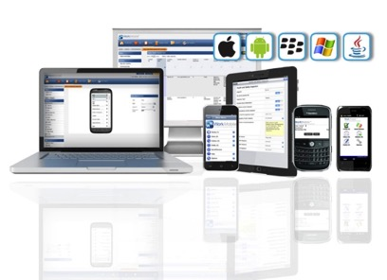






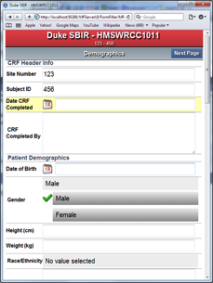
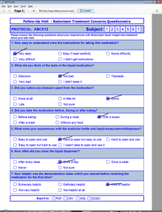

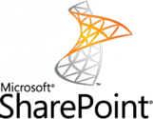









Flexibility
Any device, Any data type:
Compatible with:
UI of your choice:
Touch/HTML
Paper-like

Slide 8

Security
HIPAA Compliance, FDA 21 CFR Part 11 Compliance
  HTTPS & VPN Communication
Detailed session reports
  SSL Certificates
Session hashing
  Full Audit Trails
  Authentication
  Unique IDs
Encryption
  Password Aging

Slide 9



Eliminate Paper, Save Time, Cut Costs
Real Results Achieved by
Mi-Corporation Customers
Reduced a 2-4 week process to 1-2 days
Increased invoicing speed by 25%
Annual cost savings of $3 million dollars
Notes:
First are a bit obvious, eliminate the paper – the costs, the risks, the delays, the errors, and the manual processes that it binds you to. Refer consulting #’s 5-100 per form, cost and risk with lost or misplaced filing costs, retrieval – costs to scan

Slide 10
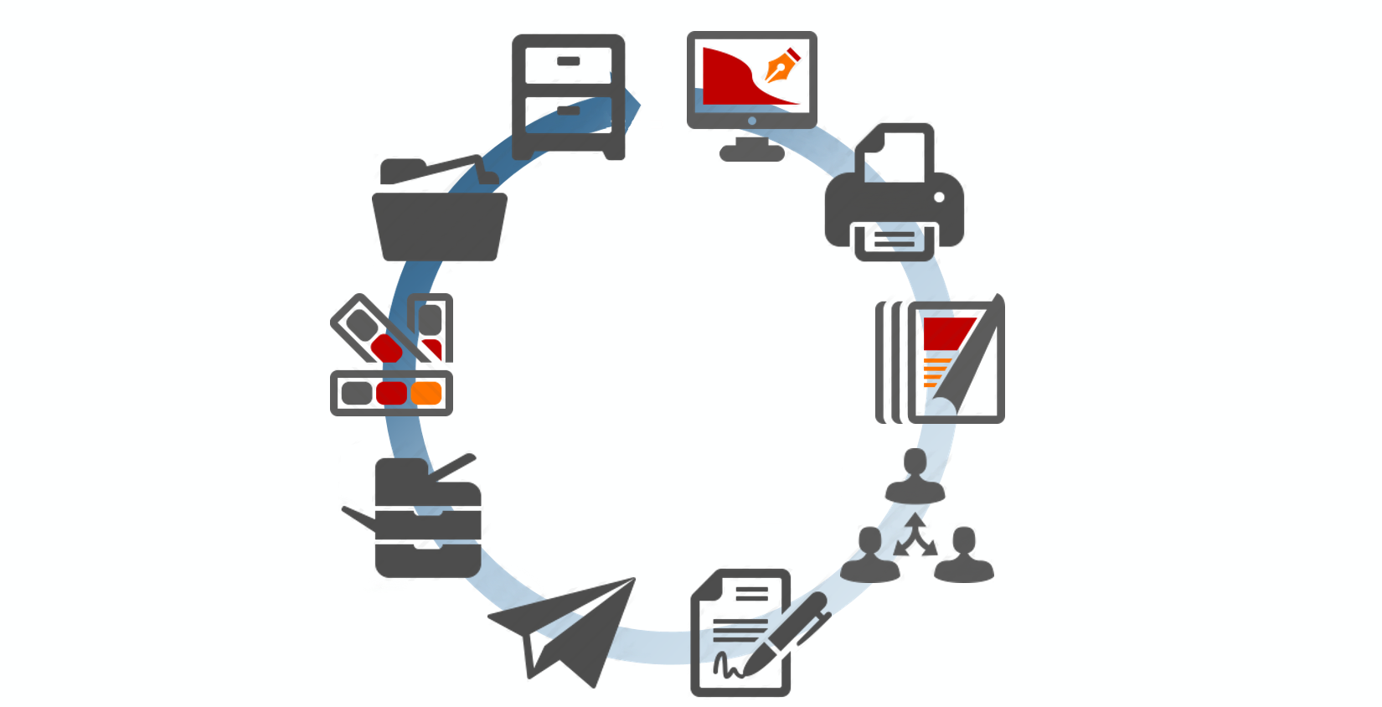


Process Reduction using Mobile Impact Platform
File
Design
Index
Print
Typical Paper Form Workflow
(Business case)
Compliance/Reporting
Supplies/ Resources
Delays
Errors
Scan
Distribute
Route
Complete

Slide 11
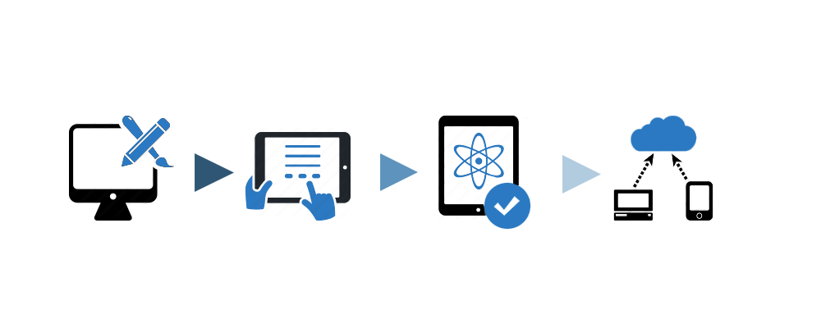
Mobile Impact Platform
Design
Capture
Verify
Communicate
Notes:
Designer, client, server

Slide 12

Benefits of a Mobile Impact Platform
Higher Revenue
Grow:
Better Productivity
Cleaner Data
Improve
Reporting Process
Improve
Sales, Support
Save :
Reduce Error
Improve Workflow
Reduce Latency
Improve Efficiency
Improve Utilization

Slide 13

Benefits of a Mobile Impact Platform
What Can We Do?
Gain A Competitive Edge
Increase
Data Accuracy
Accelerate
Information Processing
Optimize Cost Efficiency
Eliminate Redundant Processes
Streamline
Employee Productivity

Slide 14

Offline Capabilities
No Connection? No Problem

Slide 15




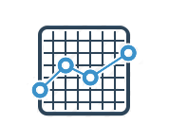






Mobile Impact Platform Architecture
5
Charts
Reports
Mi-Analytics
4
Management
Payroll
2
Mi-Enterprise
Middleware Servers
1
3
Servers
Supervisors
Employees

Slide 16


Mobile Impact Platform Architecture
5
Charts
Reports
Mi-Analytics
4
Management
Payroll
Offline Data Replicator
2
Mi-Enterprise
Middleware Servers
1
3
Workflow
Servers
Supervisors
Employees

Slide 17
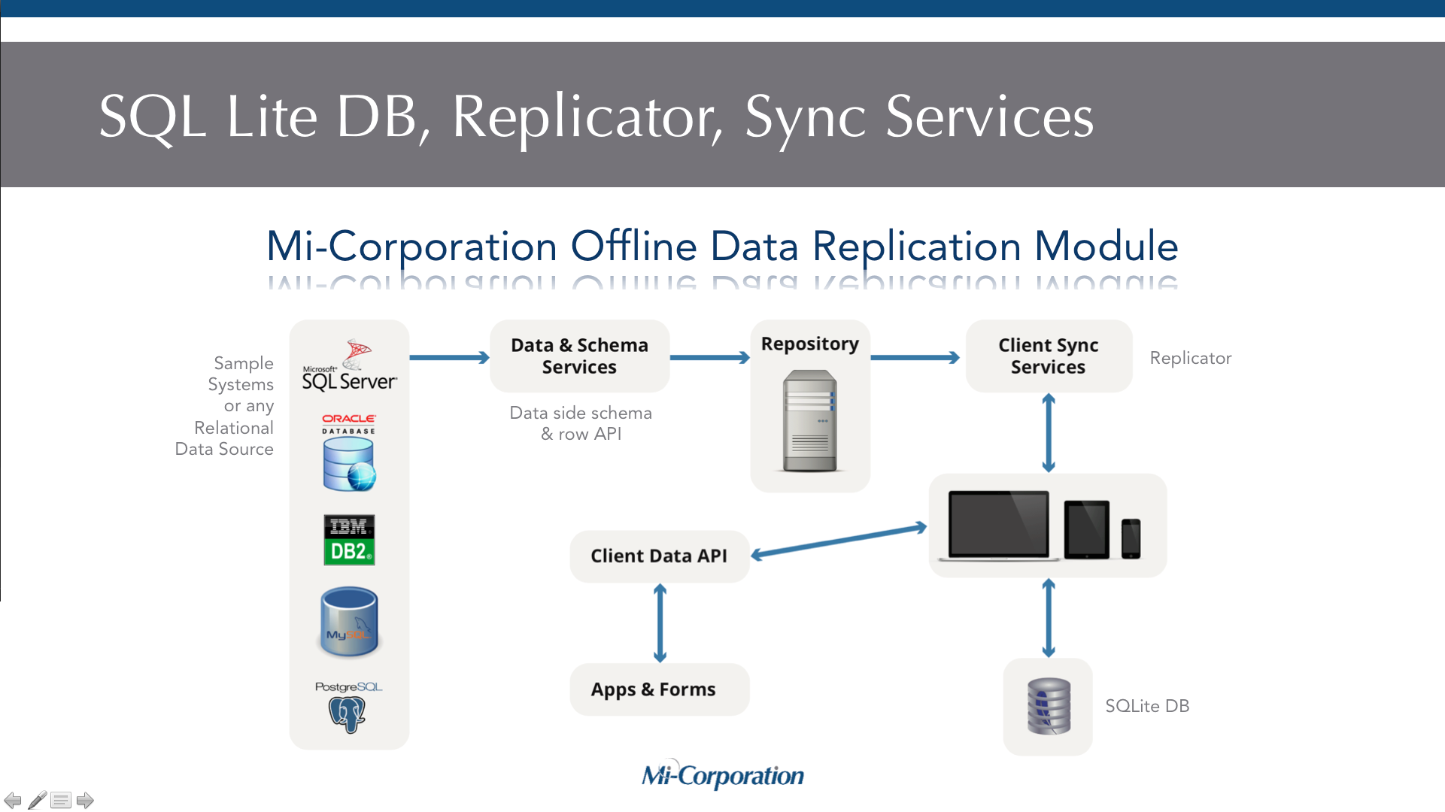
Mobile Impact Platform Architecture
5
Charts
Reports
Mi-Analytics
4
Management
Payroll
Offline Data Replicator
2
Mi-Enterprise
Middleware Servers
1
3
Workflow
Servers
Supervisors
Employees

Slide 18
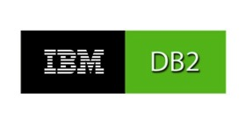




Mobile Impact Platform Architecture
5
Charts
Reports
Mi-Analytics
4
Management
Payroll
Offline Data Replicator
2
Mi-Enterprise
Middleware Servers
Client data API
& sync server
Data &
schema services
1
3
Sample systems or
relational data source:
Servers
Supervisors
Employees

Slide 19
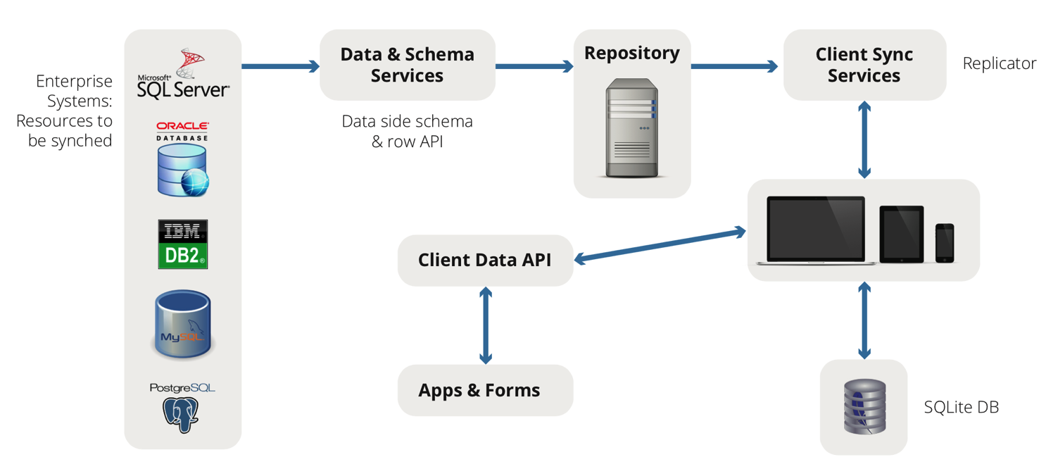
SQL Lite DB, Replicator, Sync Services
Mi-Corporation Offline Data Replication Module
Sample Systems
or any
Relational
Data Source
Replicator
Data side schema & row API
SQLite DB

Slide 20






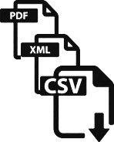



Mobile Impact Platform Architecture
Designer
Dynamics CRM,
Other Backend
Database
Paper
Forms
Mi-Enterprise
Middleware
Server
Offline Data
Replicator
Workflow
Data
Exports
Mi-Analytics
SQL Server
Oracle
Customer DBs
Any
Device
& Online/Offline
SQL lite

Slide 21
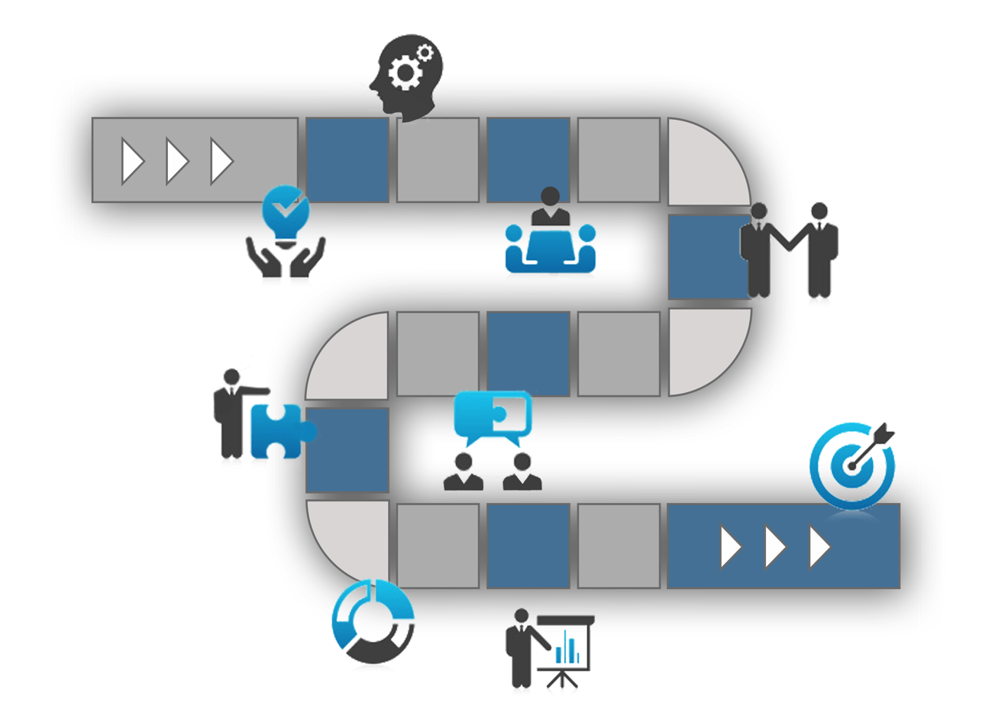






Mi-Corporation Sales Process
1
2
Decide
Evaluate
3
4
Select
Manage
5
6
Measure
Celebrate

Slide 22
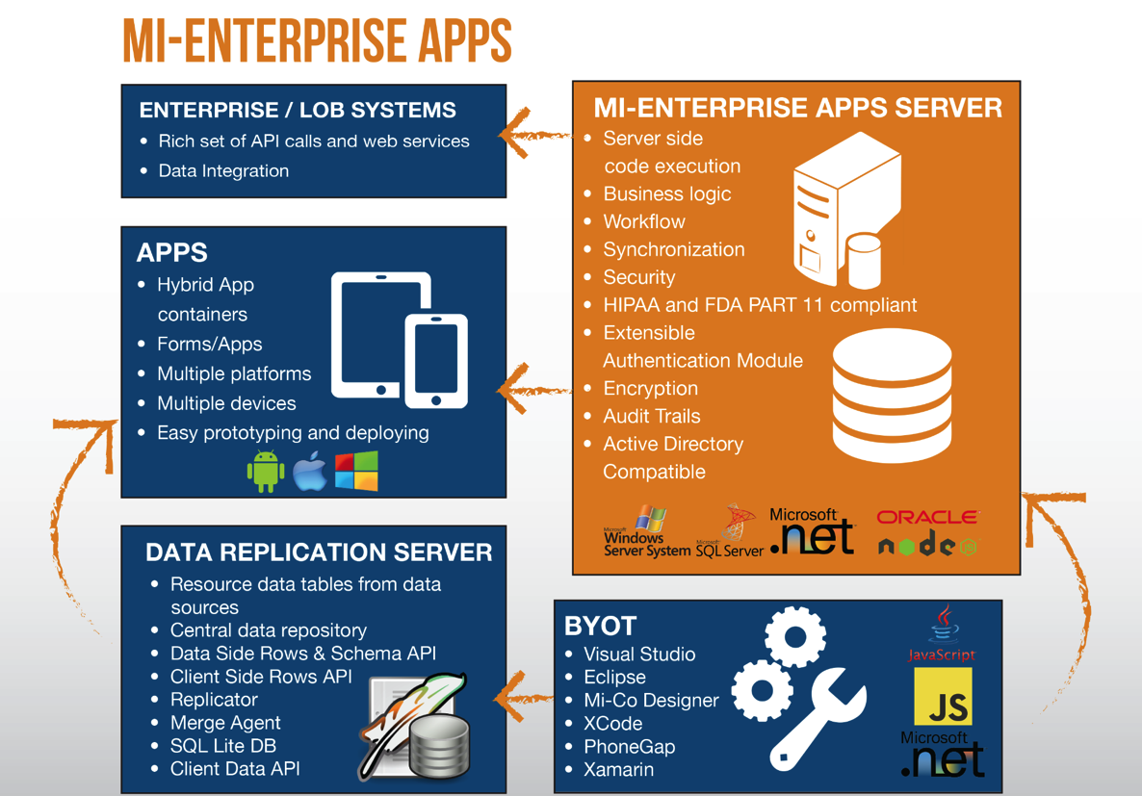
Mi-Enterprise Apps

Slide 23




Mi-Enterprise Apps
Mi-Enterprise Middleware Server
Enterprise/LOB Systems
BYOT
Data Replication Server
Apps

Slide 24
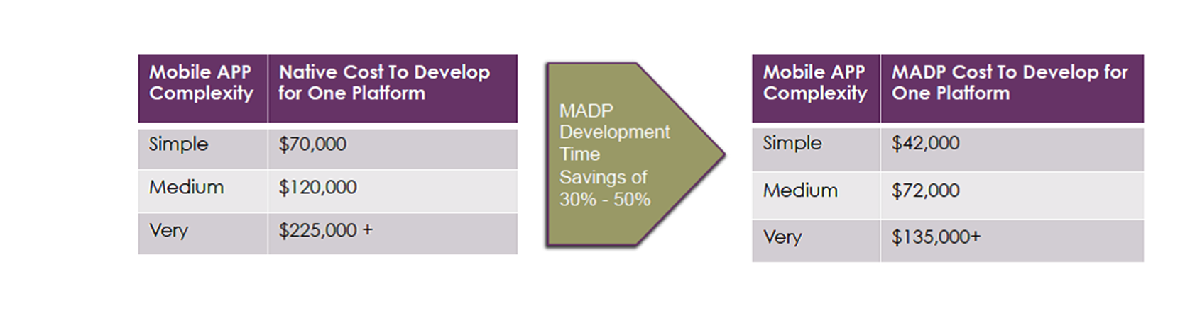
Business Case: Typical Mobile App Project
User Management
Offline Sync
Data Security
Integration w/ Enterprise Systems
Workflows & Logic

Slide 25
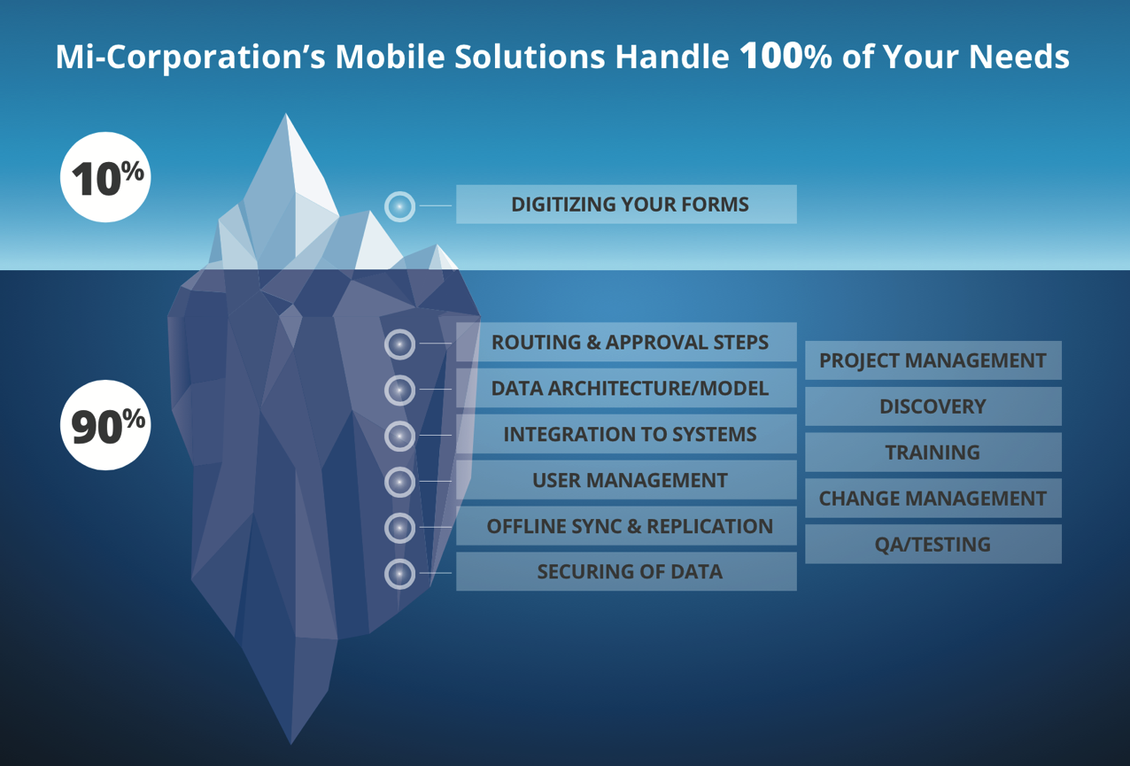
Complications of a Data Capture Process

Slide 26

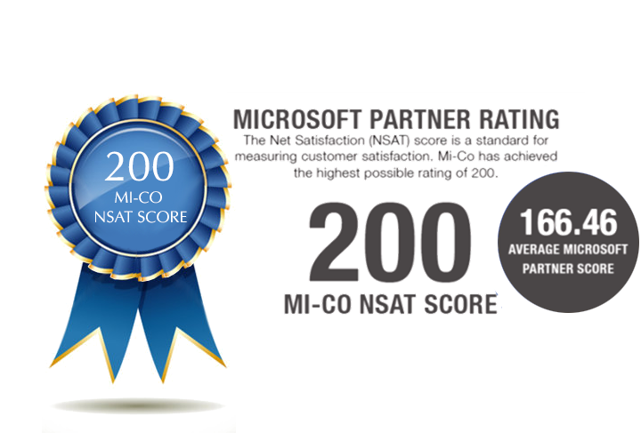
Excellent Service & Support Proven
Service & Support Matters

Slide 27
Why Mi-Corporation?
Proven
Best Offline Capabilities
Top-Notch Support
What sets us apart?
Enterprise
Intellectual Leadership
Most Flexible

Slide 28




Next Steps
Connect with Mi-Corporation!
Schedule a Free Mobility Consultation
& Tailored Demo
For Your Business Case
Visit us @ www.mi-corporation.com
linkedin.com/company/mi-co
Contact:
[NAME], [TITLE], Mi-Co
email@mi-corporation.com
919-ABC-EFGH
youtube.com/micortp
twitter.com/mi_Corporation
facebook.com/MiCorporation

