Slide 1
Mi-Co Channel Partner Session
Sales Strategies & Best Practices
Gautham Pandiyan
gpandiyan@mi-corporation.com
April 16-17
www.mi-corporation.com

Slide 2

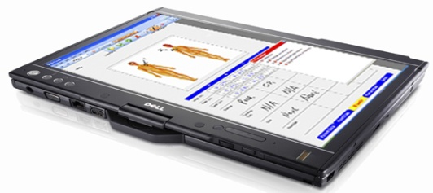

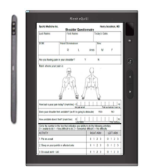

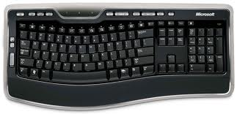

Mi-Forms Best-of-Breed Mobile-Forms Solutions
Sales Strategies & Best Practices
Gautham Pandiyan
gpandiyan@mi-corporation.com
919-485-4819 ext. 1973

Slide 3
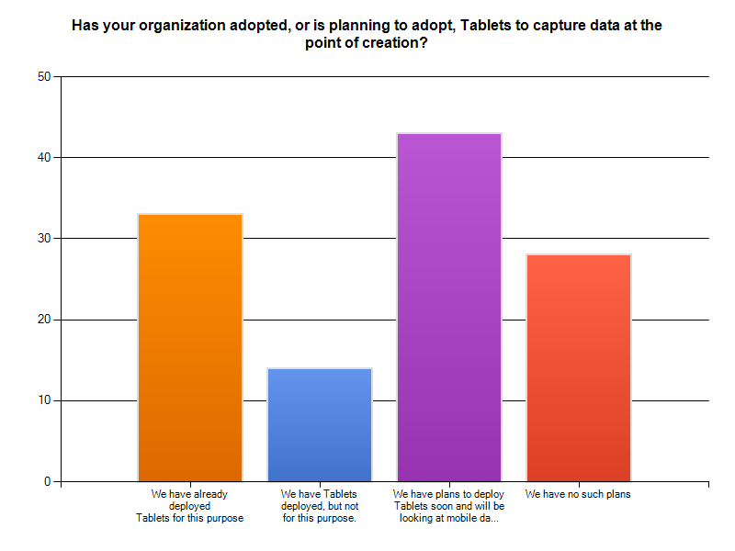

Slide 4
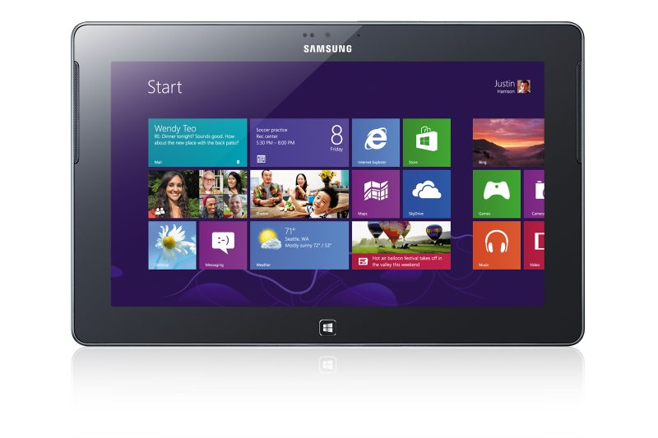
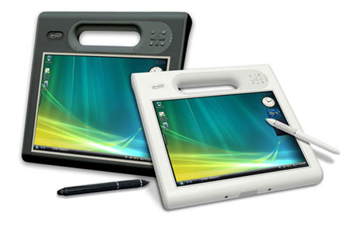
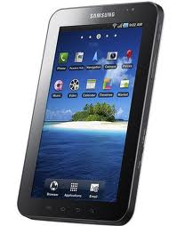
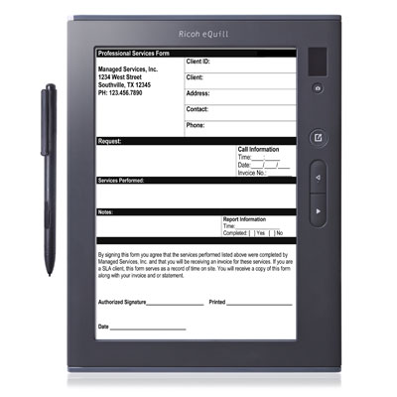
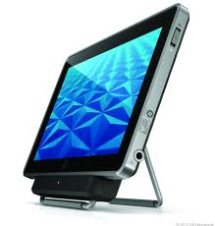
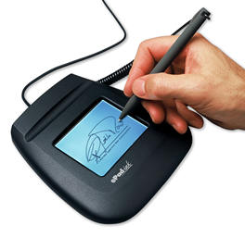
It’s a BYOD, Diverse World!

Slide 5





















Select Mi-Co Customers
Wilson County
Home Health

Slide 6
The Value Proposition
Typical customer problems Mi-Forms can solve:
Save time by eliminating paper forms where data must later be typed in the system.
Save money & boost revenue – staff time processing paperwork is expensive and can be used in higher value-add activities like seeing more patients
Reduce costs such as printing, scanning and storage of paper forms
Improve data quality – real-time data validation and automatic uploading reduce errors
Faster access to data for reporting and analysis
Go Green with paperless processes

Slide 7
Who is the Ideal Target?
Organizations looking for a flexible, scalable, enterprise-class ‘mobile-forms’ solution
Not someone just looking for a generic ‘e-forms’ solution
Business Unit Managers (mainly Operations); CIO organization in parallel
- Medium-large organizations
- Mobility/Tablet initiative
- Currently on paper
4) $50 million+, 100+ employees

Slide 8

Tip 1: Show Love to the Mi-Co Partner Portal
Why?
  You can sell better if you know past success stories to reference at a moment’s notice
Partner resources
  Rebrandable/co-brandable collateral
  Updated Partner Getting Started guides, sales manuals, pricing info
  Drop-ship marketing campaigns (HTML email templates etc.)
  Deal Registration Portal
  Variety of industry form samples…
  Lot more to HELP you!..

Slide 9

Tip 2: Harvest the Existing Customer Base
Why?
  Lowest hanging fruit!
Action Steps
  Make sure EACH of your existing customers knows about this flexible, powerful technology at a time when Tablets & Mobile are so hot!
  If you currently do business in non-mobile oriented departments (like HR, Accounting etc.), ask for referrals to Operations folks, IT
  Visit customers and ask if they still use paper for data capture, show demos
  Ask these friendly customers for referrals to others, feedback

Slide 10

Tip 3: Register Qualified Deals with Mi-Co
Why?
  Mi-Co commits active support & any special pricing to the first partner to register a ‘qualified’ deal approved by
  Mi-Co
  Mi-Co can steer customers that reach out to us directly via website, back to you to work with
Gets Mi-Co personnel engaged and assisting you as needed to help close the joint-win!

Slide 11

Tip 4: Avoid the Endless Pilot Trap
Why?
  You will expend a LOT of resources & time and hope to get to decision makers & get a rollout order
Instead…
  Show similar canned demos available from Mi-Co & your team
  Design 1 page/part of their form in presales, if the opportunity merits it
  Get a 14-day Mi-Forms eval license for no cost for a limited trial
  Purchase a Mi-Forms Term License in increments of 3 months
  Ask for a “Letter of Intent” to be signed for a 1-month pilot
    Define success criteria for the pilot
    Signatories are typically decision makers so you don’t get stuck at a lower level

Slide 12
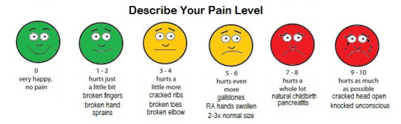
Tip 5: Quantify the Pain
Why?
  You can tell the customer what cost their INACTION has and you can make a powerful business case
How?
  Ask for detailed metrics
  (how much time spent in data-entry, how many FTEs, how much paper is printed, scanned, how many errors in process etc. etc. etc.)
  Bracket rough range of metrics if above not available/hard to get
  (does billing normally take 2-3 days after the job, or say 5-7? etc.)
  Associate costs with these metrics to put COST OF INACTION in front of the customer, in addition to ROI

Slide 13

Tip 6: Have Swagger
Why?
  LOTS of new competitors, noise, and confusion in the marketplace
And you can go in with confidence since…
  You are backed by a company with:
    13 yrs. experience in this space,
    Hundreds of success stories,
    Extremely flexible technology ,
    And GREAT customer service & support

Slide 14

Tip 7: Become a Demo Dolly!
Why?
  Mi-Co is happy to help you with demos via web, in-person and more, but as we grow rapidly, you can be more self-sufficient if you’re proficient with demos…
Tips to get there…
  Get the NFR software
    Use your fav. Tablet/D Pen/Laptop
  Practice, practice, practice (via web, in-person etc.)
  Have a back-up plan (YouTube video, screenshots)

Slide 15
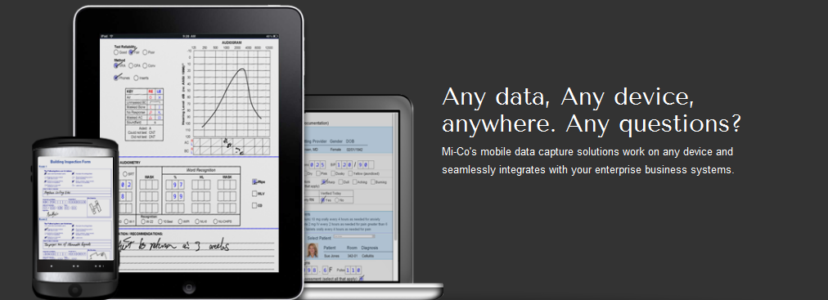
Tip 8: Know the Competitive Differentiators
Proven: 13 years experience building mobile-forms Flexible: Any data, any device solutions from the ground-up for Tablets & mobile anywhere. Support for maximal devices input options, hardware devices, integrations
Enterprise: Robust, scalable technology that has Intellectual Property:
passed audits by Eli Lilly, Sutter Health and AT&T 10 issued US patents covering digital writing technology, including 7,869,655, 7,486,824 6,798,907, others pending

Slide 16
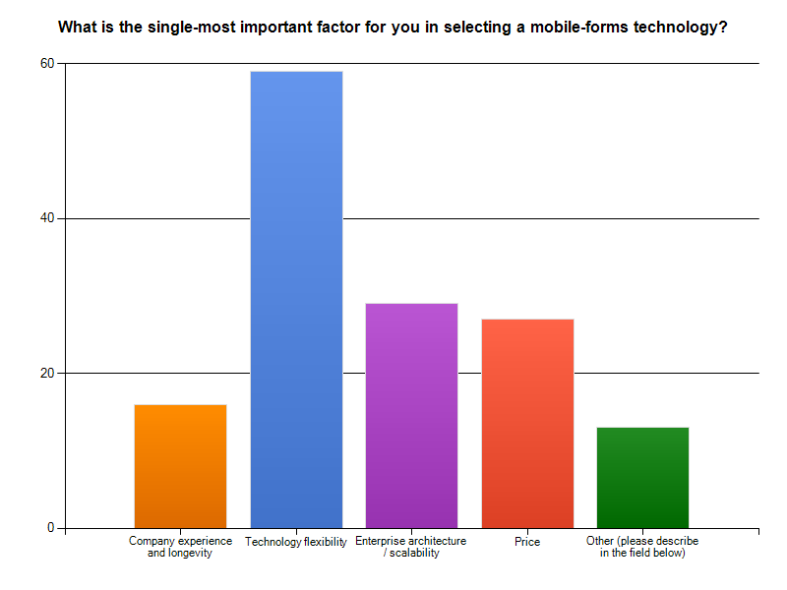
Why does this matter?
Notes:
In Wilson County, Debra Harris, Home Health Director, estimates that nurses are able to save one hour per nurse per day on paperwork*. Rather than increasing the number of visits nurses made each day, the nurses are given the time to provide more quality care to their patients. Harris concludes that the quality of care and patient satisfaction increases based on this use of the time.
During a six month time frame (and before a fully completed implementation of the Mi-Forms System), Wilson County saw a reduction in the number of late submissions from up to 31% in a month to 8% in a month.
*Current national salary surveys show an average of over $20 per hour for a home health nurse. Using this data, the Wilson County productivity gain is $1200 per day (or $24,000 per 4 week month, more than four times the monthly cost of the software, hardware and wireless systems currently being used by Wilson County).

Slide 17

The Market Categorization
Vertical Software $$$ Users hate it* Long deployment cycles | Custom App Development $$$ IT hates it** Long development cycles
Mobile Forms Capture $$ User friendly IT friendly Shorter deployment cycles
!!!!!
*June 2009, “Nuance Survey shows that 90% of doctors are “concerned” about usability of EHR”
**2011 AIIM/OpenText Survey, “Greater than 30% cannot justify mobile app development costs”

Slide 18


Tip 9: Generate Own Leads to Receive More…
Why?
  We like to reward the partners that are making a strong effort to penetrate their market spaces
Planning & Execution Steps
  Work with Mi-Co on a lead-gen/marketing plan on an annual and quarterly basis
  Help Mi-Co understand your ‘sweetspot’ & expertise
  Keep Mi-Co posted on your efforts, progress

Slide 19
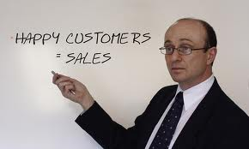
Tip 10: Post-Sales - Support & Service like Crazy
Why?
  Happy customers = referrals and we differentiate based on phenomenal support & services!
Random Thoughts…
  Do customer support & service feedback surveys regularly
  Guarantee a 1-business day response time
  Move customers to Time & Materials contracts
  Ask customers frequently why they are happy, and provide informational guidance about future trends/topics
  Gather feedback for Mi-Co on areas of improvement

Slide 20

Pricing

Slide 21
Flexible Pricing Models Overview
Flexible Mi-Co Pricing Options
Named-User Model
(Limited users, unlimited form submissions)
Basic, Dept. Enterp.
Monthly pricing, per
named- user
(on-premise/hosted)
Perpetual license
(1-time fee with 20%
optional annual maintenance)
Form-Transactional Model
(Unlimited users, limited form submissions)
Tiers of form-packs from 10,000 – 1,000,000
(like prepaid cell card)

Slide 22
Named-User Categories
Perpetual, Term & Hosted options
Up-sell options for VARs with existing customers
Lower entry-point price with basic products
Simple, easy to quote model based on named-users

Slide 23


Form-Transactions (Usage) Model
As many user licenses as needed
Requires Mi-Forms Server Software to be setup/used for monitoring
“Packs”, expire in 1 year
Partners can host or deploy on-premise

Slide 24

Keys to Success with Mi-Co
Communication, Communication, Communication!
  Updates, forecasts, asking for help
Energy, enthusiasm & drive
Trust, openness & fair play

Slide 25

Thoughts on Vertical Markets…
Healthcare & Government top 2 verticals
  Allied, non-traditional healthcare
“Field Inspection” fastest-growing vertical
New promising areas include:
  Utilities
  Energy
  Mining
  Oil & Gas
  Sales (order-entry)
  Manufacturing

Slide 26
Thank you & Let’s Shoot for Mutual Success!!!
Gautham Pandiyan
gpandiyan@mi-corporation.com
919-259-4124

