Slide 1

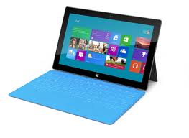
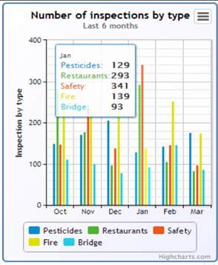

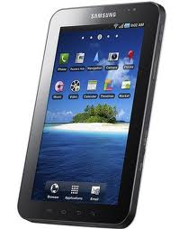
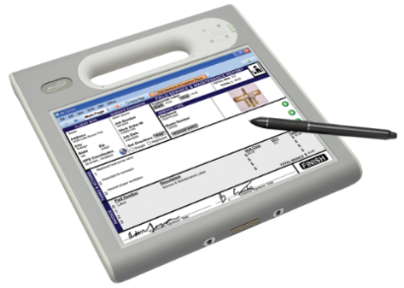
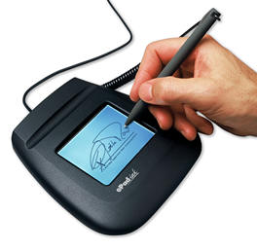
Mobile Inspection Software by Mi-Corporation:
Overview & Live Demo
Gautham Pandiyan
gpandiyan@mi-corporation.com
919-259-4124

Slide 2
Agenda
Introductions
Mi-Corporation background
Mobile Inspection Software Workflow Automation
Mobile Inspection Software Product Overview
Customer Case Study
Mi-Corporation Ecosystem
Live Demo
Next Steps/Feedback

Slide 3
Why Do We Do What We Do?
“We strongly believe mobile information positively impacts the world”
- of our customers
- of their customers
- of their stakeholders
- and their communities

Slide 4
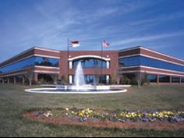
Mi-Corporation Overview
14 years of Enterprise Mobility Software Experience
  - Founded 1999
Enterprise Mobile Data Solutions to optimize mission-critical processes
  Any data, Any Device, Anywhere!
  Flexible, scalable, secure & mature (v10)
Partnered with industry leaders
  - Intel, Microsoft Gold ISV, Panasonic, Motion Computing,
  Samsung, Anoto & more
Intellectual leadership
  10 issues US Patents, 3 more pending

Slide 5
















Select Mi-Corporation Customers

Slide 6
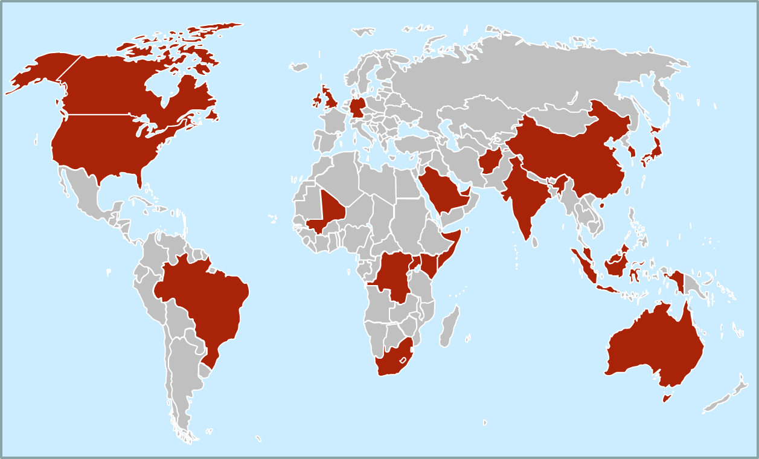
Mi-forms Users Around the World
USA
Canada
Brazil
UK
Switzerland
Kenya
Somalia
South Africa
Australia
Singapore
Malaysia
China
Saudi Arabia
Afghanistan
India
South Korea
Japan
Mali
Congo
UAE
Uganda
Any Data, Any Device, Anywhere
Notes:
We are a global company, with resellers in various geographies, capable of supporting global companies in their global deployments. Our software has been deployed & used in a number of countries around the world

Slide 7
Customer Problems We Solve
Employee productivity hampered by paper, data-entry, no historical context for past inspections
Processes are redundant, not streamlined or efficient as could be
Costs are adding up with manual data-entry, printing, mailing, scanning paper etc.
Lack of near real-time data, slows billing, other processing, no KPI/metrics visibility
Data accuracy issues with the constant need to fix errors on the back-end
Competitive pressure to use technology for better customer service & turnaround
Notes:
Which one of these typical problems are you most concerned about or trying to solve?

Slide 8





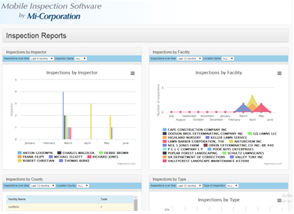

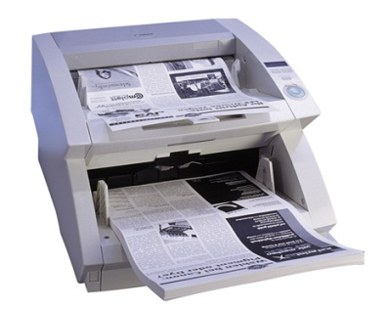


Typical Paper Inspection Workflow
Design Form
Print Form
Distribute Form
Complete Form
File Original
Index & Route
Scan Form
Route Form
Analytics
Approximate cost of a paper form: $4.95
- AIIM Whitepaper, 2012
Notes:
Part of rationale for mobile data capture projects. While this is an average across many industries & companies, can you afford to incur these types of costs for much longer? Mention our ROI tool that we will showcase at the end that can give them their specific process cost/KPIs. Mention how analysis/reporting comes after all this and may or may not be accurate/immediate/useful

Slide 9
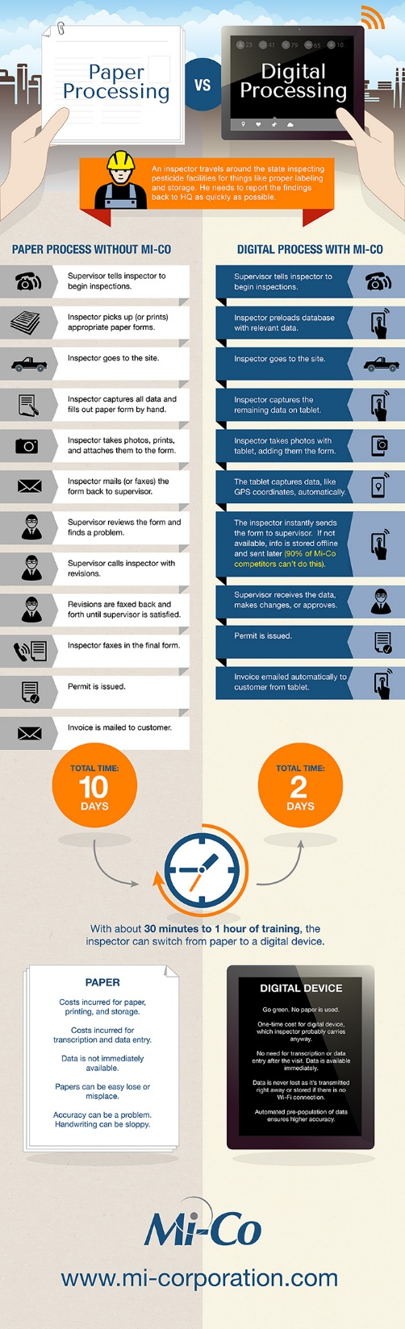
Paper Process
With Mi-Co
10 days
2
days

Slide 10


What is Mobile Inspection Software (MISM)?
End-to-End Software System that allows organizations to digitize their field inspection process from the field to the dashboards/reports/analytics
Send out to an inspector to perform an inspection
Provide historical data on past inspections or reference info (even offline)
Pre-populate fields on the inspection form to save inspectors time
Collection of rich multimedia data (photos, GPS, barcodes, RFID etc.)
Submission of inspection data to supervisors for approval workflow
Export of approved data in near real-time to preconfigured database
  Includes preconfigured reports, charts, graphs, dashboards

Slide 11
Mobile Inspection Software Components
Mi-Forms best-of-breed Mobile-Forms software for data collection & processing
  Mi-Forms WYSIWYG Designer for building forms (GUI)
  Mi-Forms Client for capturing and validating data (Windows, iOS, Android, HTML5)
  Mi-Forms Server for information communication, administration & workflow
  Mi-Forms.NET SDK for customization, embedding within other apps, 3rd party integrations
MISM Database Repository & Dashboard
  Database tables automatically configured when forms are designed
  Pre-configured reports, charts, graphs
  Approval and KPI dashboard
  Hosted or on-premise options

Slide 12
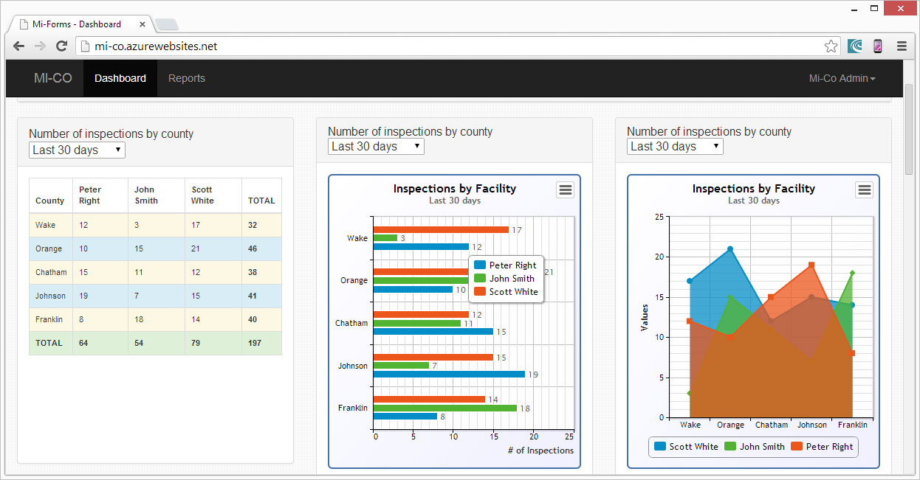
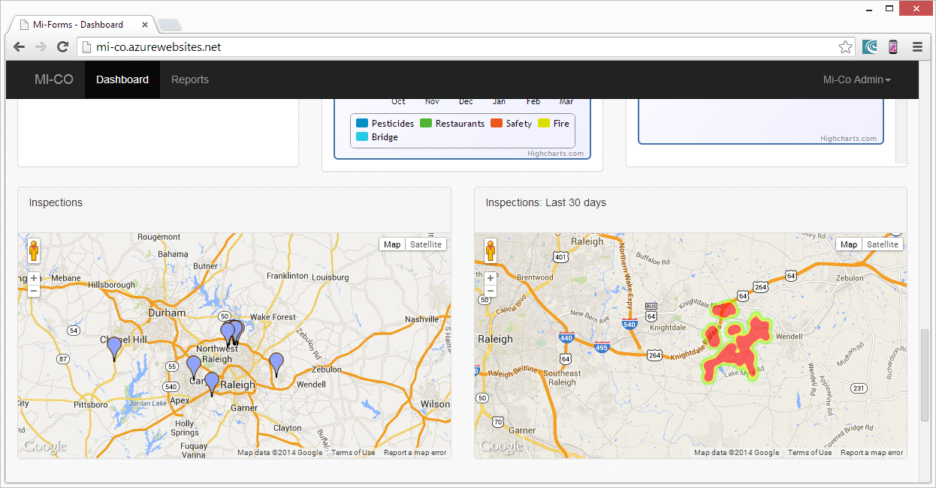
Mobile Inspection Software Screenshots
Standard Charts
By inspector
By location
By date
Custom Charts
Through configuring
data views and
admin dashboard

Slide 13
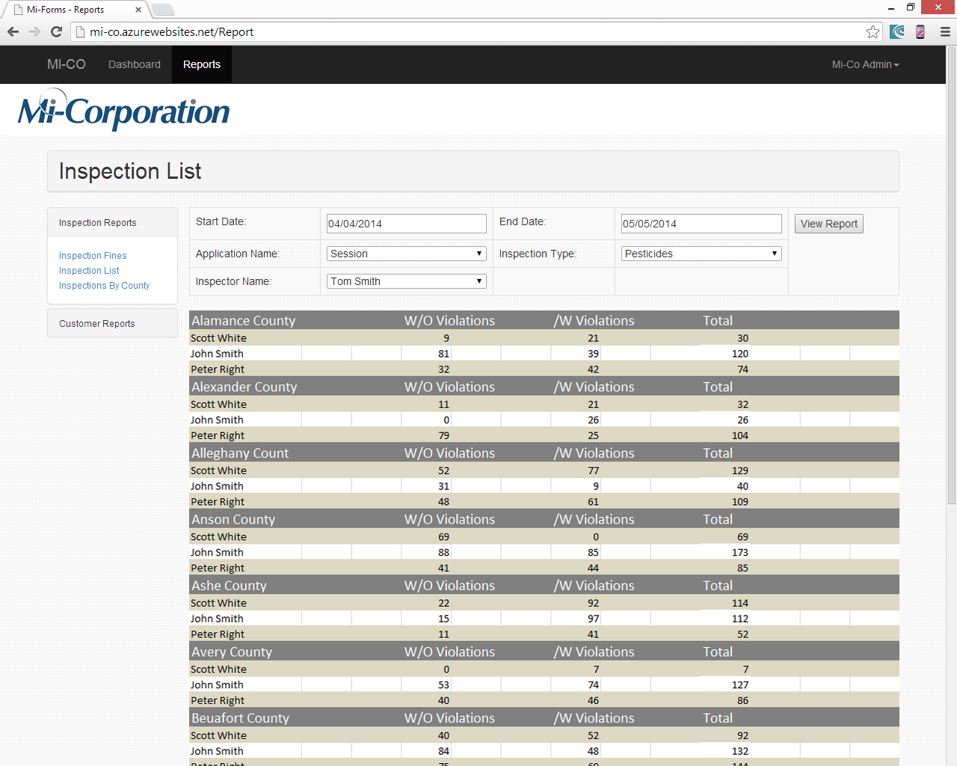
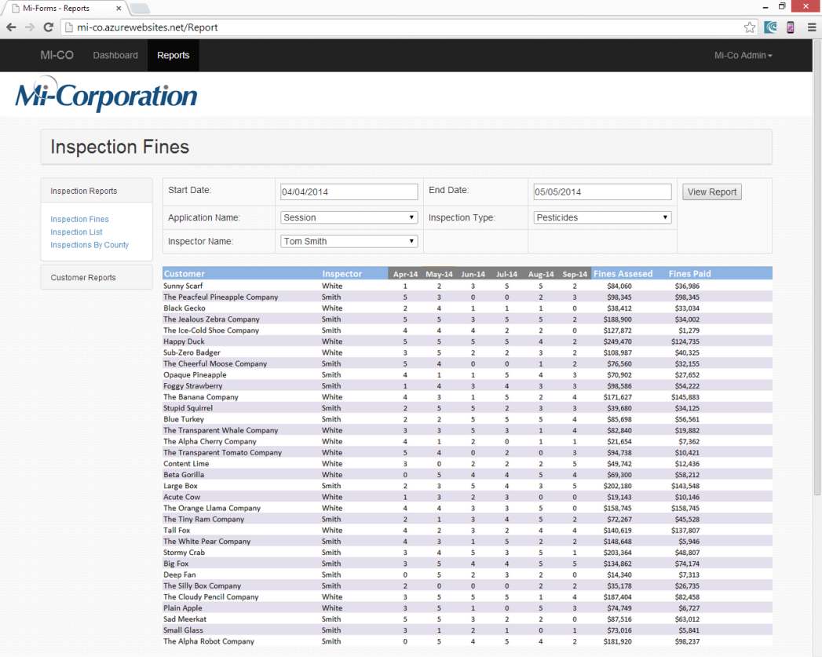
Mobile Inspection Software Screenshots
Reporting Tools
SQL Server Reporting Services
Export to PDF, Excel, Word, JPG etc.
Dashboard customization
Setup links to report

Slide 14
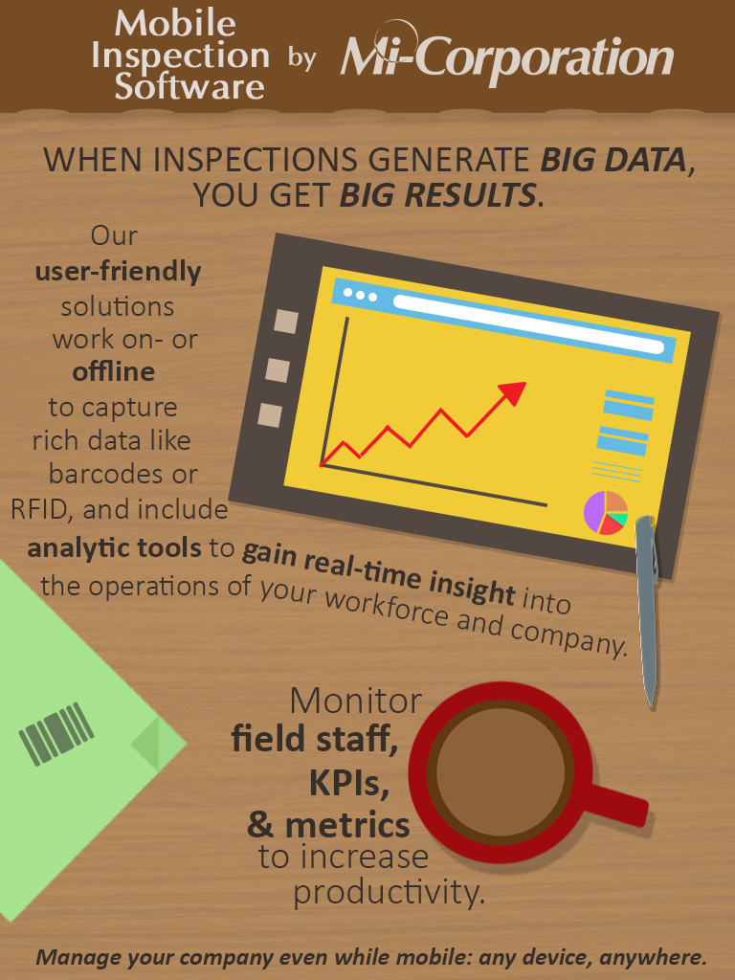

Slide 15











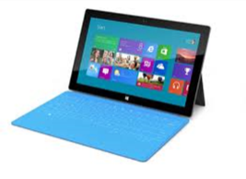
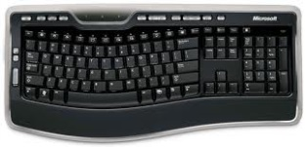









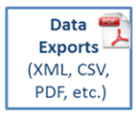






MISM Technical Architecture
SQL Lite DB
Enterprise
Systems
Data Replicator
Server
Online/Offline Pre-Fill
Billing
Scheduling
ERP System
SQL Server
Oracle
Others
MISM Repository
(Hosted/on-prem)
Workflow
Notes:
Designer – like Powerpoint; FormBridge for Mi-Forms allows conversion into Mi-Forms format from Word, PDF, Infopath etc. etc.
Server – 4 roles
Version control & updates (automatic)
User management (compatible with AD out of the box)
Authentication (compatible with AD out of the box)
Workflow (approval routing, based on group membership & queues)
Offline – data lookups also possible using our new data replicator module that replicates a SQL Lite DB to any device for reference info; can also lookup from a CSV file traveling with the form

Slide 16





















MISM Technology: Maximal Flexibility

Slide 17
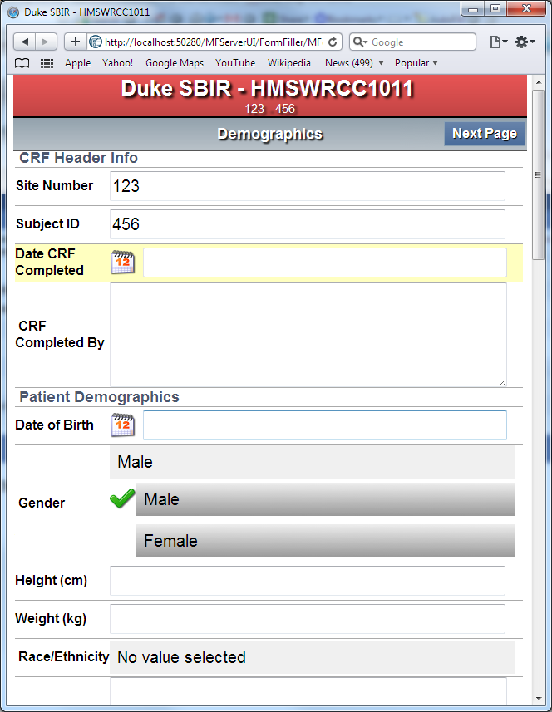
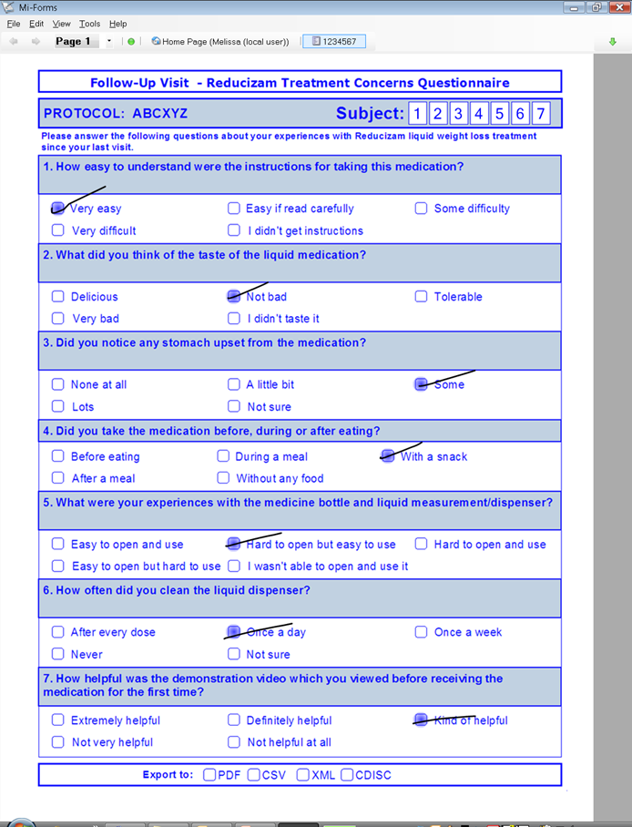
Flexibility: Pick the UI of your Choice
HTML/Touch interface for smaller devices
‘Paper-like’ layout for larger devices

Slide 18



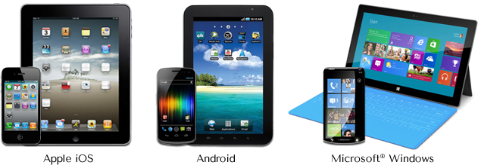
Flexibility: Any Data Type Supported
Flexible Technology
Client Experience
14
years

Slide 19


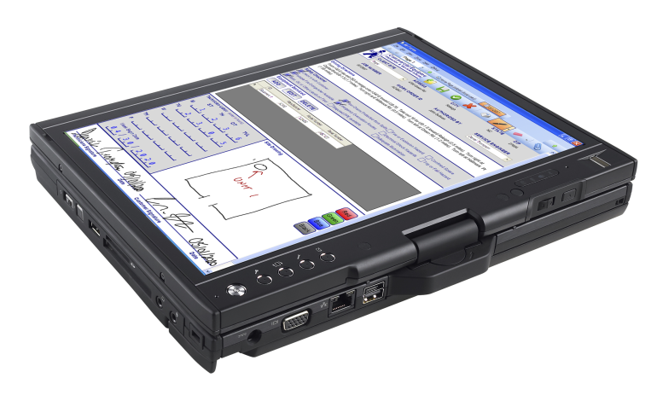
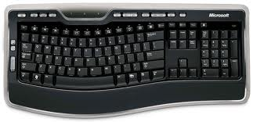
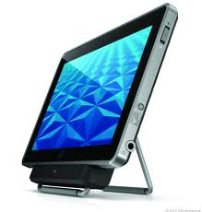
Flexibility: Any Device Supported

Slide 20
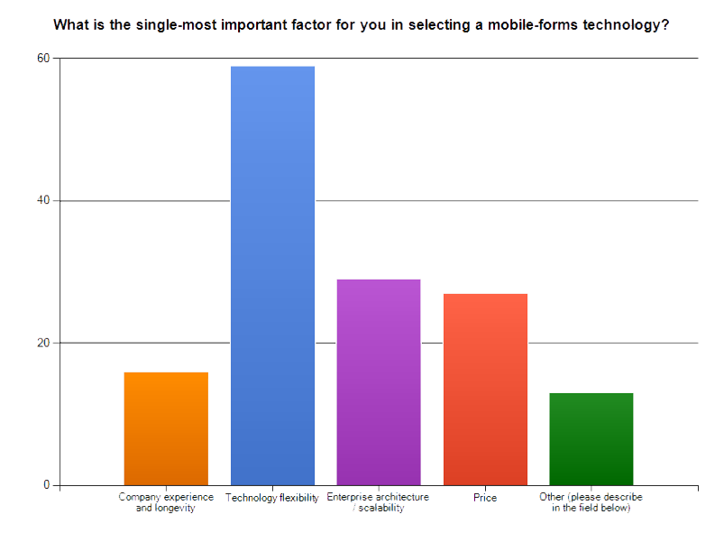
Flexibility Matters to the Market

Slide 21
What Sets Mi-Corporation Apart?
Proven: 14 years experience building mobile-solutions from the Most Flexible: Any data, any device solutions from the ground-up for Tablets & mobile, best practices, training Support for maximal devices, input options, hardware devices, integrations
Enterprise: Robust, scalable technology that has Intellectual Leadership: 10 issued US patents
passed audits by Eli Lilly, Sutter Health and AT&T covering digital writing technology, 3 others pending
Top-Notch Support: Highly responsive, achieved top Best Offline Capabilities: Allowing lookups, secure
possible score of 200 on MSFT NSAT rating (200 scale) data sync & more, even when disconnected

Slide 22
Enterprise-Class Security Matters
High levels of security and control, highly vetted
  Mi-Corporation passed audits by global companies like Eli Lilly, AT&T, Quintiles, Sutter Health etc.
    For good software development practices, HIPAA compliance, FDA 21 CFR Part 11 compliance
  HTTPS and VPN communication, SSL certificates, hashing, full audit trails, unique IDs, password aging and encryption
  In-process data contained in proprietary, encrypted XML format
  Detailed session reports on any form-session stored:
    U/N, device name, session open time, Mi-Forms versioning, O/S versioning, Memory availability, battery level remaining, session end time & potential session transmission time
    Ink-Capture on form with Stylus: Each ink-stroke is time-stamped, each point’s pressure data recorded in the XML data
  Session hashing: security tags against XML export & internal passwords for uploads
  Authentication:
    On Start of Mi-Forms & Finish/Upload of the form session
    Lockout of accounts based on failed authentication
    Active Directory Compatibility

Slide 23
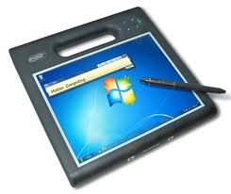
Customer Case Study –
NC Dept. of Agriculture
Pesticides inspections
  About 20 field inspectors
    Turnaround time: 2-3 weeks
    Paper forms, mailing, transcribing, data-entry
  Mi-Forms on Tablet solution
    Instant lookups of database in field, even offline
    Easy, fast data submission straight to managers
      Turnaround time: 1-2 days! (quicker)
    Improved data quality (cleaner)
    Net savings to date: ~$220,000
    Completely paperless!
  Success led to several other Government departments adopting the Mi-Forms solution for similar inspections

Slide 24
Service & Support Matter
“The continued dedication the support team provides to their customers, acts as a cornerstone to their business model.”
- Trevor Cannon, Developer, CDP
Notes:
This is not a commodity purchase; the vendor you buy from should be fully vested in your project(s), highly responsive, proactive and have proven themselves before solving customer problems and being rated highly for it

Slide 25
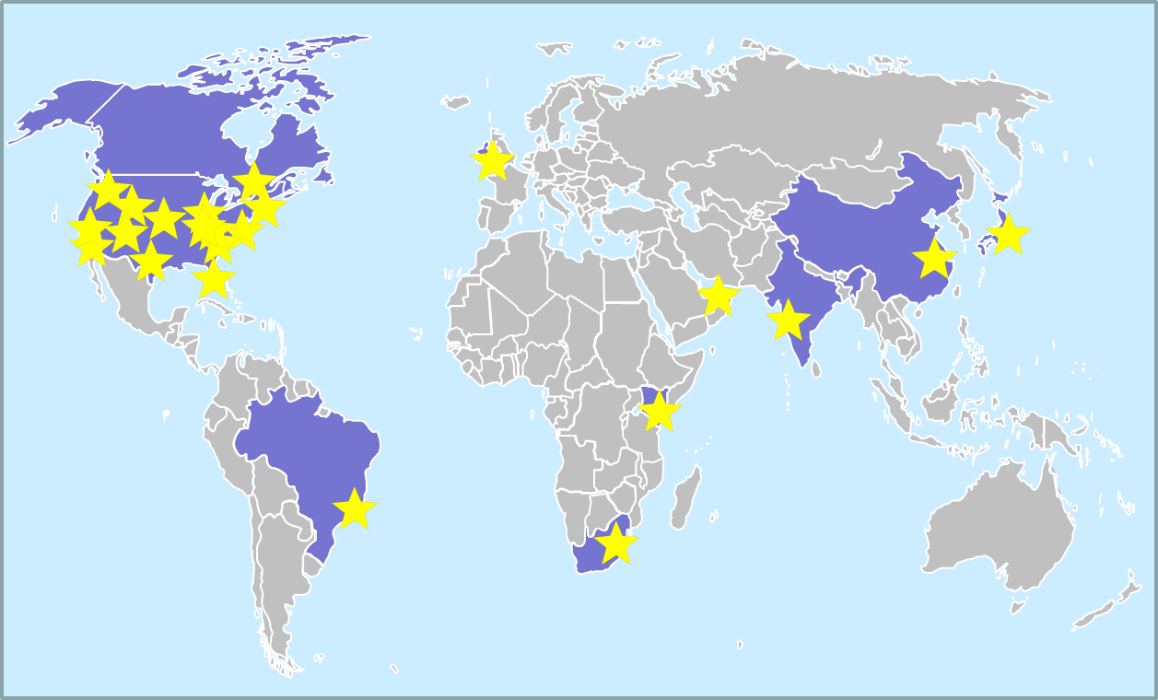
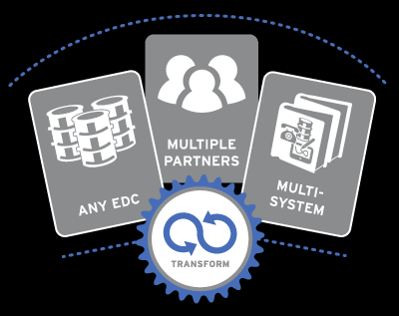

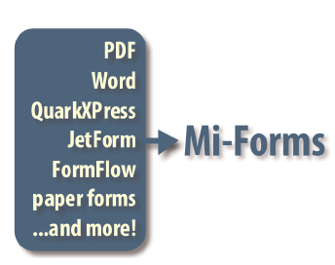
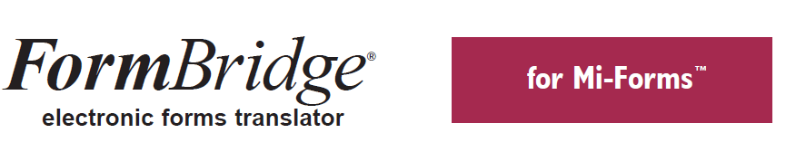
Buying Into Our Ecosystem
Integrated 3rd Party Technologies Adding Even More Value to Mi-Forms
Wide Network of Channel Partners

Slide 26

Risk vs. Return
Mobility projects are risky, complex
Lots of competitors will claim to meet your needs with cheaper products
Mi-Co frequently helps customers whose projects have failed with competitors’ technologies get back on track
  Low flexibility of the technology
  On-premise and cloud options lacking
  User adoption challenges
  Back-end integration weaknesses
How much risk can you tolerate & what’s the consequence of failure?

Slide 27
Example of Risk
I was tasked to find a way to enhance productivity and efficiencies within my group. My first though was to somehow populate the information our group was collecting in the field as a final product and eliminate inputting collected notes, pictures and drawings into our desktops back at the office. We were duplicating efforts and sometimes misplacing important documentation that required return trips.
I researched how I could utilize tablets in the field that would allow us to input all of our information collected in the field, pictures taken and drawings on one single file. I tried a variety of apps and software that although were helpful and more efficient than our current process, none were the total package. I also inquired about creating my own app but found it was more expensive than I would of ever imagined.
I spent about 10 months with these products and figured I’d have to settle with one until I searched one last time and found Mi-Co. I downloaded the trial version and could not believe what I found. Every great function of every other form was all packaged up in this one version. If I had a chance to create a form myself, this would be exactly what I’d shoot for. Not only did it have all the necessary tools the group needed and then some, but it was VERY user friendly. To top it off, the staff has been nothing short of impressive with how they continuously help with any questions, concerns and updates at a moment’s notice. I could not be any happier with this product and company. It has truly been a godsend.”
- Mike Saraceno, NE Region Manager
Construction & Engineering
Lightower Fiber Networks

Slide 28
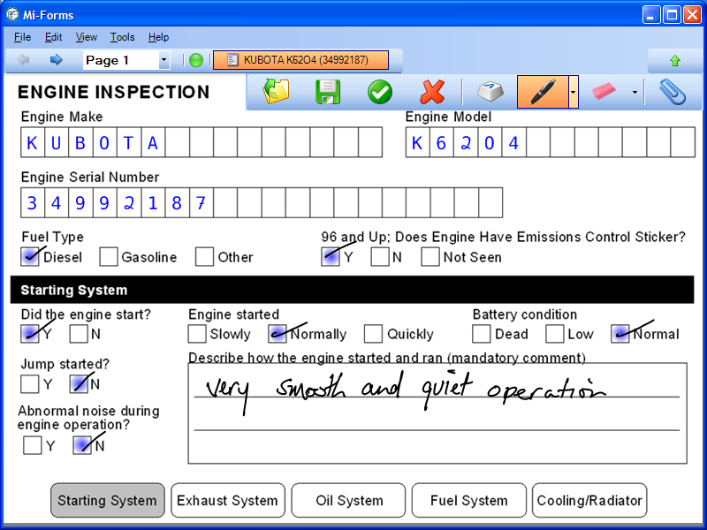
Let’s Demo!

Slide 29
Other Mobility Products from Mi-Corporation
Mi-Enterprise Apps
  Server-based middleware platform for app developers to use
  Manages users, integration, workflow, business logic, syncing, security etc.
  Allows for faster, cheaper app deployment with proven technology
  Data replication

Slide 30
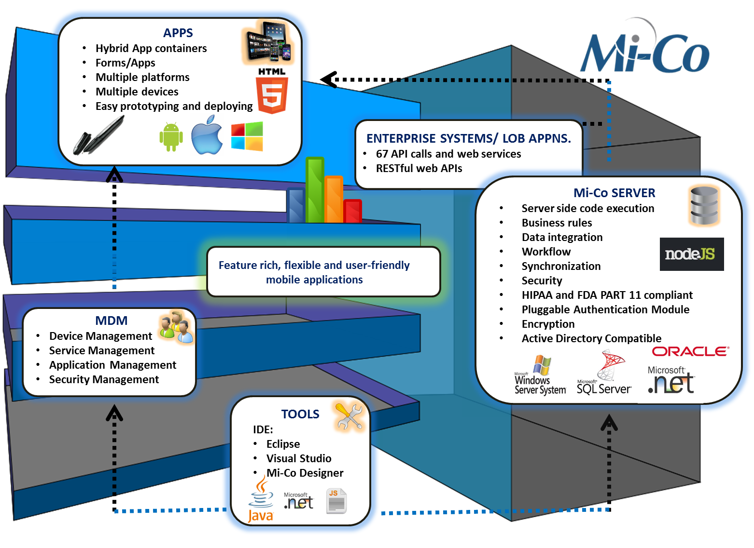
Mi-Enterprise Apps

Slide 31
Agenda
Introductions
Mi-Corporation background
Mobile Data Capture Rationale & Workflow Automation
Mi-Forms Product Overview
Mi-Corporation Ecosystem
Live Demo
Next Steps/Feedback

Slide 32
Next Steps
Visit www.mi-corporation.com for more information about
Mi-Enterprise Apps: data sheets, case studies
Downloadable eval software is available at www.mi-corporation.com
Look for Mi-Forms sample apps in the Apple and Android app stores
Watch our Youtube videos: www.youtube.com/micortp
Contact Mi-Co to get started – Gautham Pandiyan
gpandiyan@mi-corporation.com
919-485-4819 x 1973

Slide 33
Background Slide

Slide 34
Pricing Models Overview
Flexible Mi-Forms Pricing Options
Named-User Model
(Limited users, unlimited form submissions)
Monthly pricing, per
named- user
(on-premise/hosted)
Perpetual license
(1-time fee with 20%
optional annual maintenance)
Form-Transactional Model
(Unlimited users, limited form submissions)
Tiers of form-packs from 10,000 – 1,000,000
(like prepaid cell card)
MISM Data Repository Module
(Flat fee, hosted)

